Slide 1
The TOWN of Tarnobrzeg
And the town of Zaltbommel – history compared

Slide 2
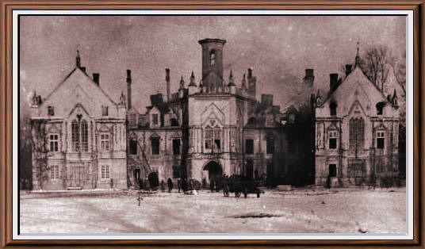
Tarnowski’s Castle(past)

Slide 3
Tarnowski’s Castle(today)

Slide 4
Tarnowski’s Castle
It was built in XV century
First it was a defense fort
Later it was adapted by Tarnowski’s falmily and became their mansion
It was used as a school
Nowadays it’s a history museum

Slide 5
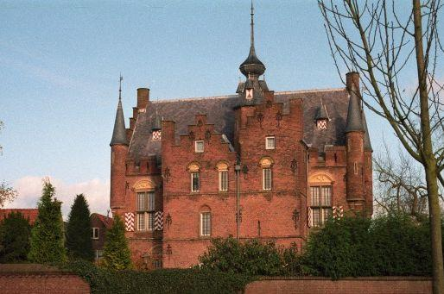
Tarnowski’s Castle – Zaltbommel’s version

Slide 6
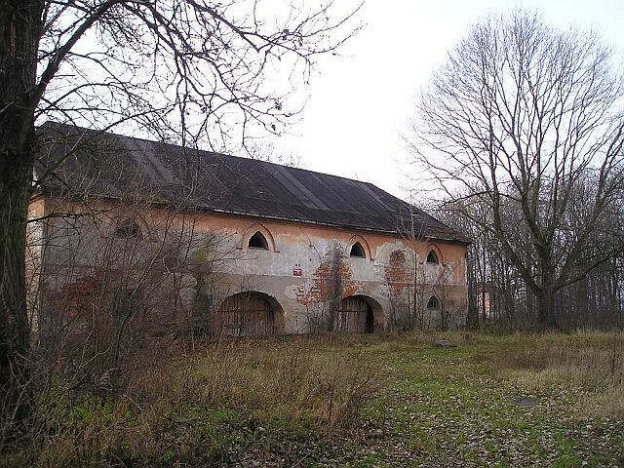
Granary(past)

Slide 7
Granary

Slide 8
Granary
Built in year 1843
It burnt down
It was rebuilt in 1991
Now it’s serves as a museum

Slide 9
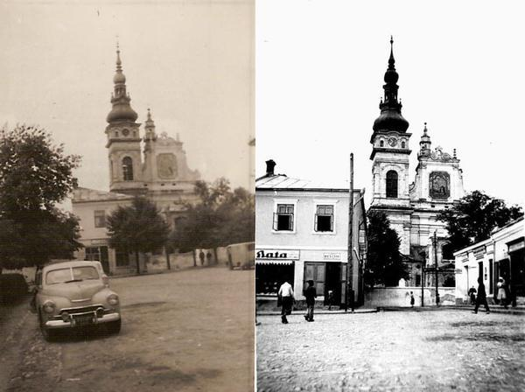
The Monastery of Dominican Order(past)

Slide 10
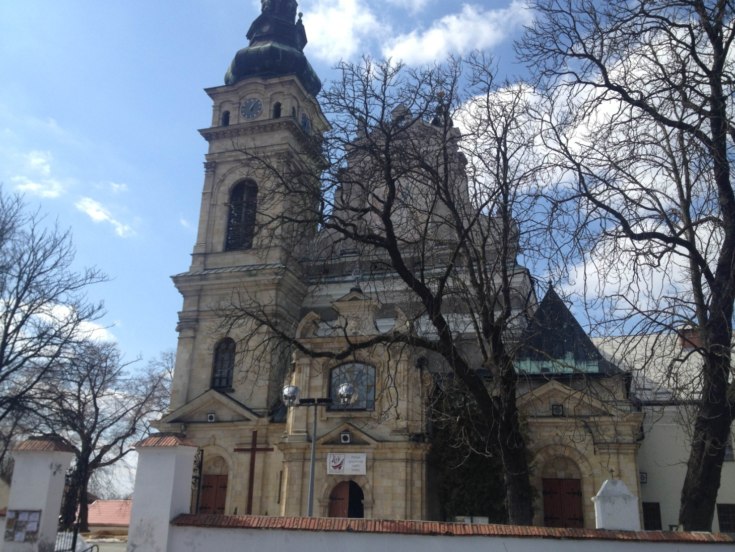
The Monastery of Dominican Order(today)

Slide 11
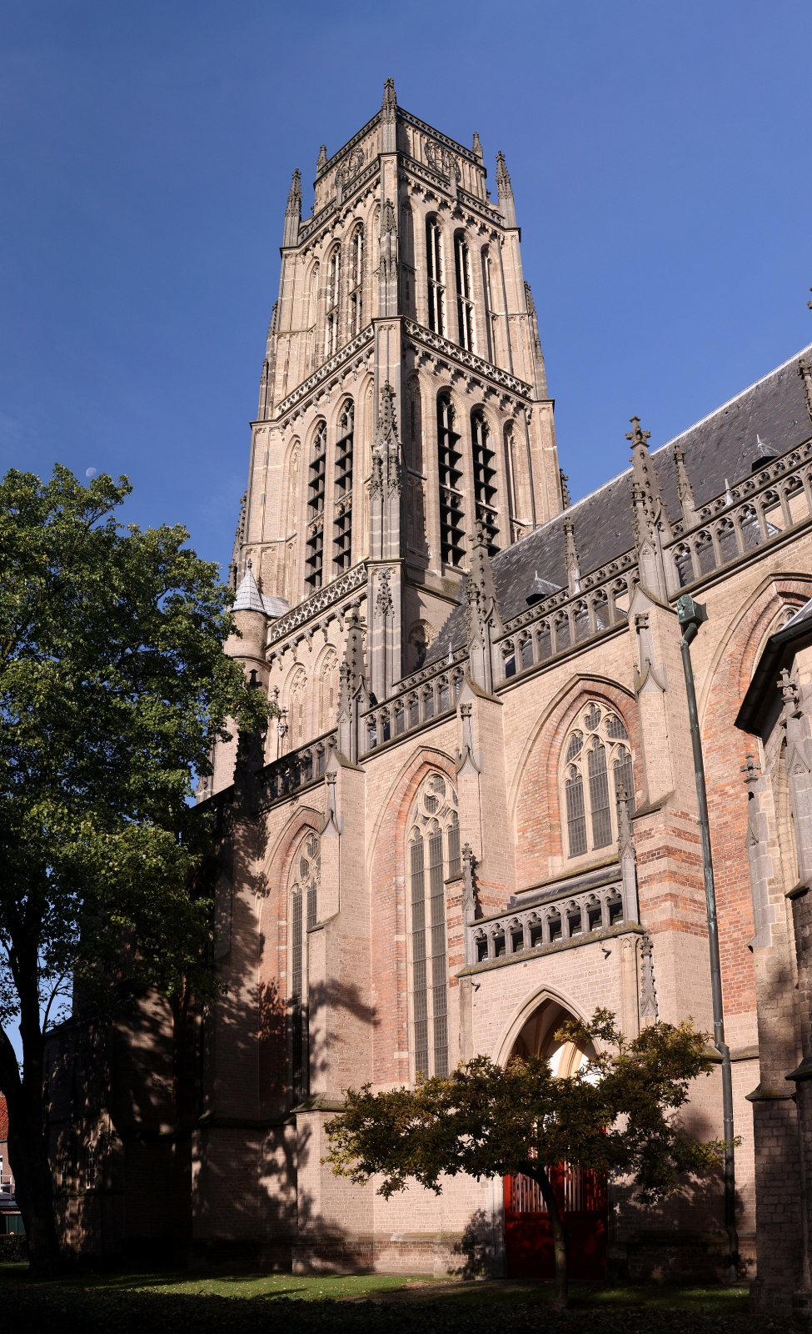
The Monastery – Zaltbommel’s version

Slide 12
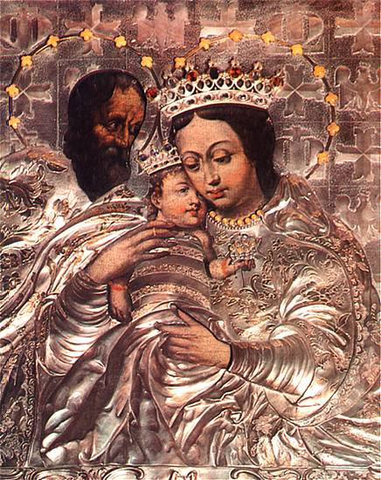
The Monastery of Dominican Order
It was finished in 1706
A saint painting showing the Mother of God can be found above the church’s altar

Slide 13
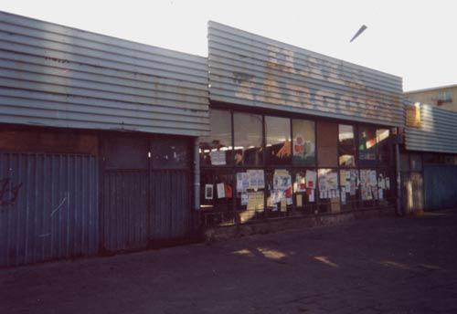
Market Hall(past)

Slide 14
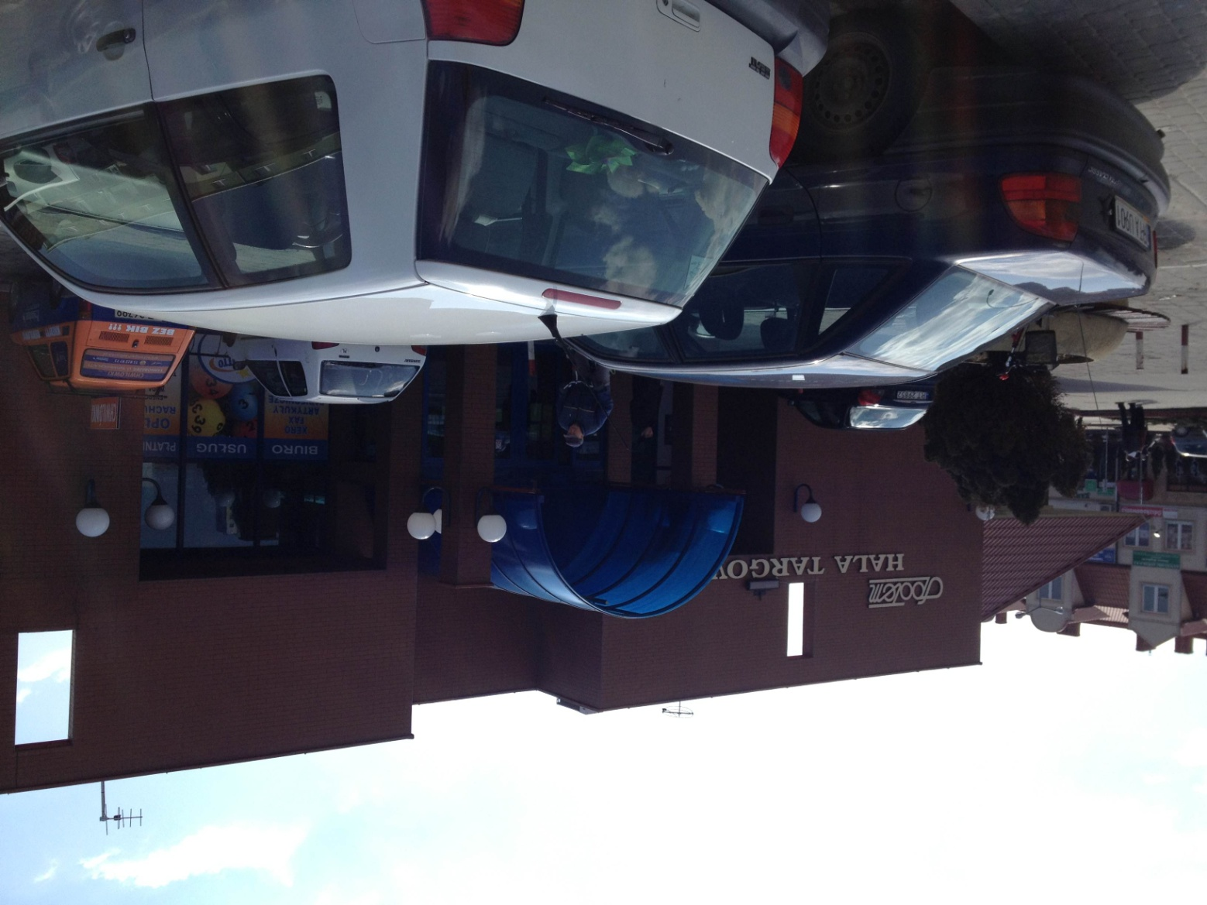
Market Hall(today)

Slide 15
Market Hall
It is placed at the same spot that used to be a Jewish Cemetery
That Cemetery was founded in XVII century
It was completly destroyed during WWII by german soldiers

Slide 16
Market – Zaltbommel’s version

Slide 17
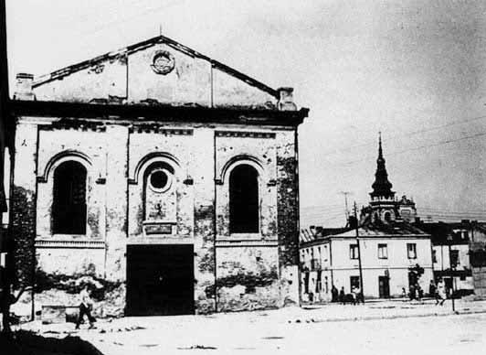
Library/Synagogue(past)

Slide 18
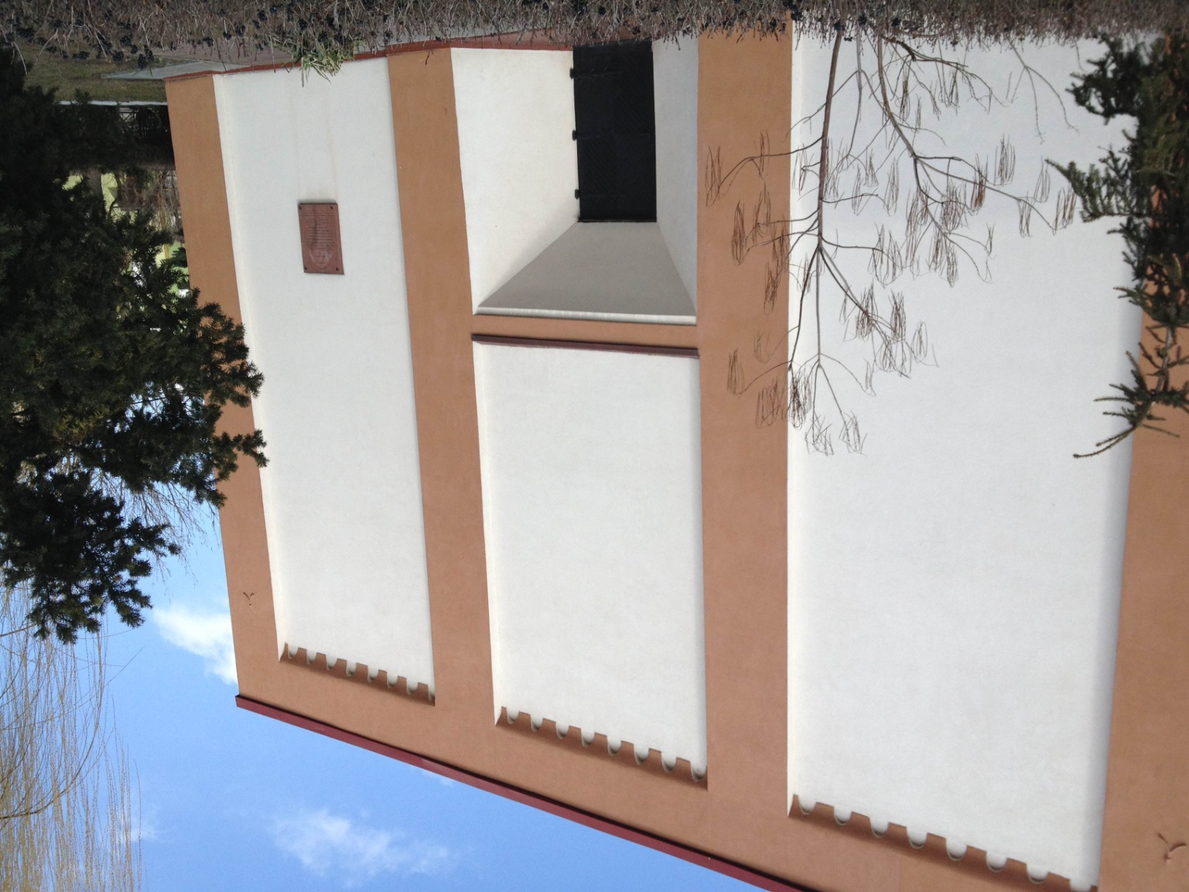
Library/Synagogue(today)

Slide 19
Synagogue – Zaltbommel’s version

Slide 20
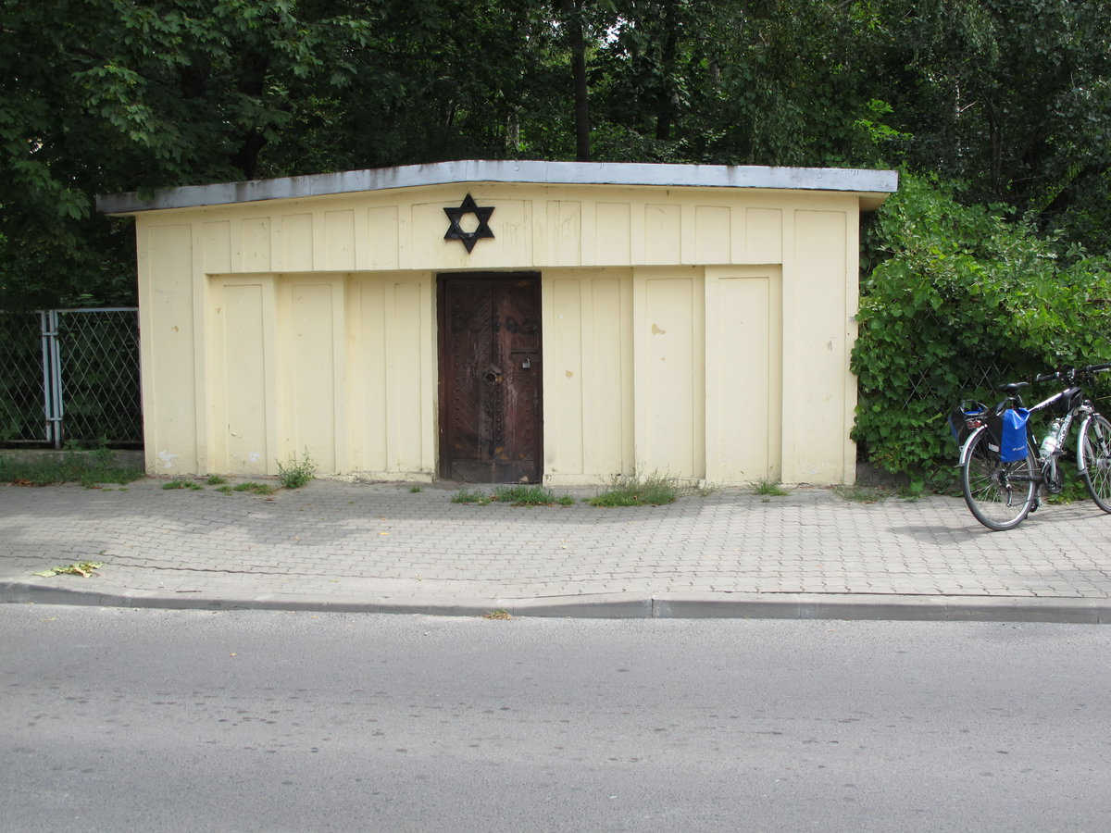
Jewish Cementery(past)

Slide 21
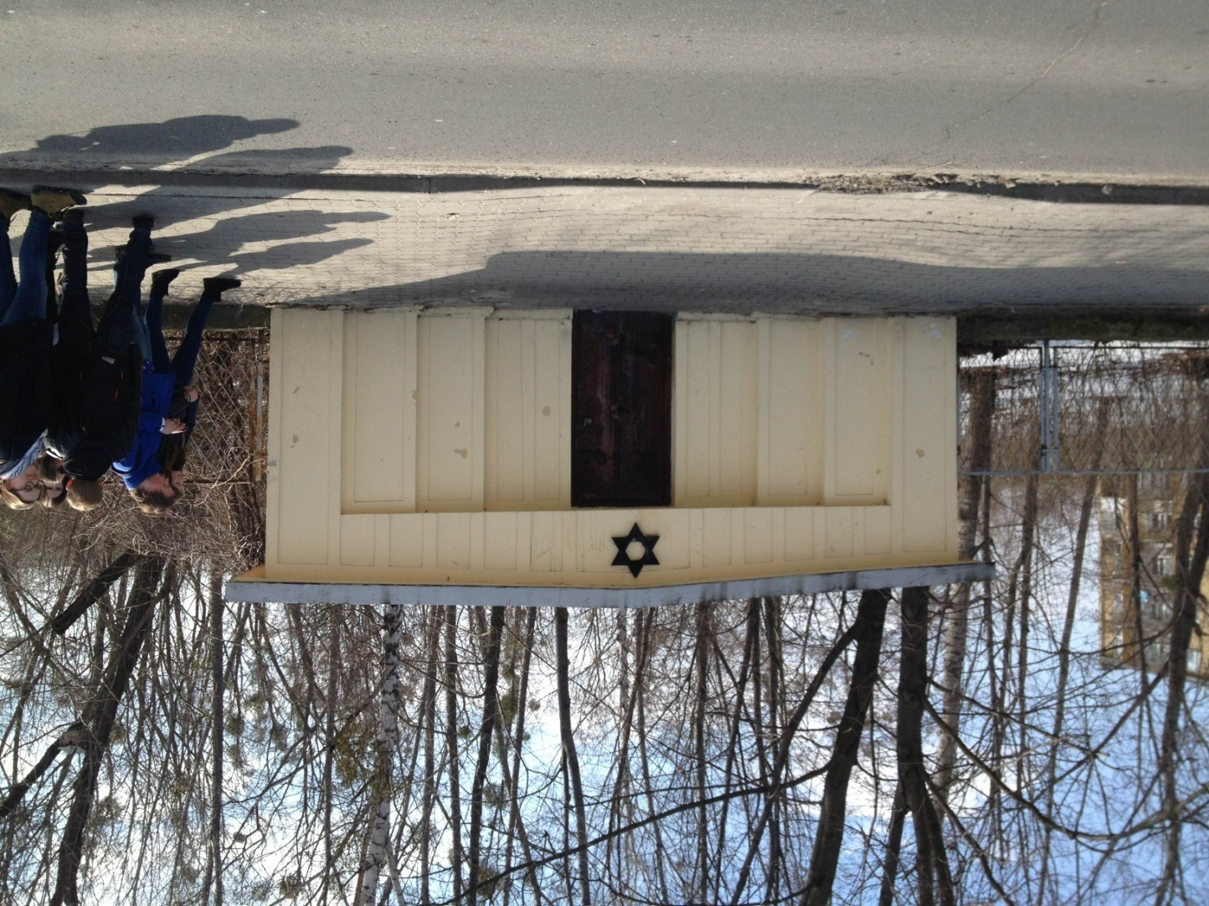
Jewish Cemetery(today)

Slide 22
Jewish Cemetery
It was founded in 1930
It was ruined during WWII by nazis, gerries and other bitches
There are only 4 gravestones left

Slide 23
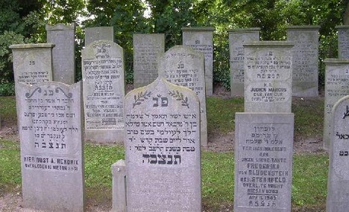
Jewish Cemetery – Zaltbommel’s version

