Slide 1
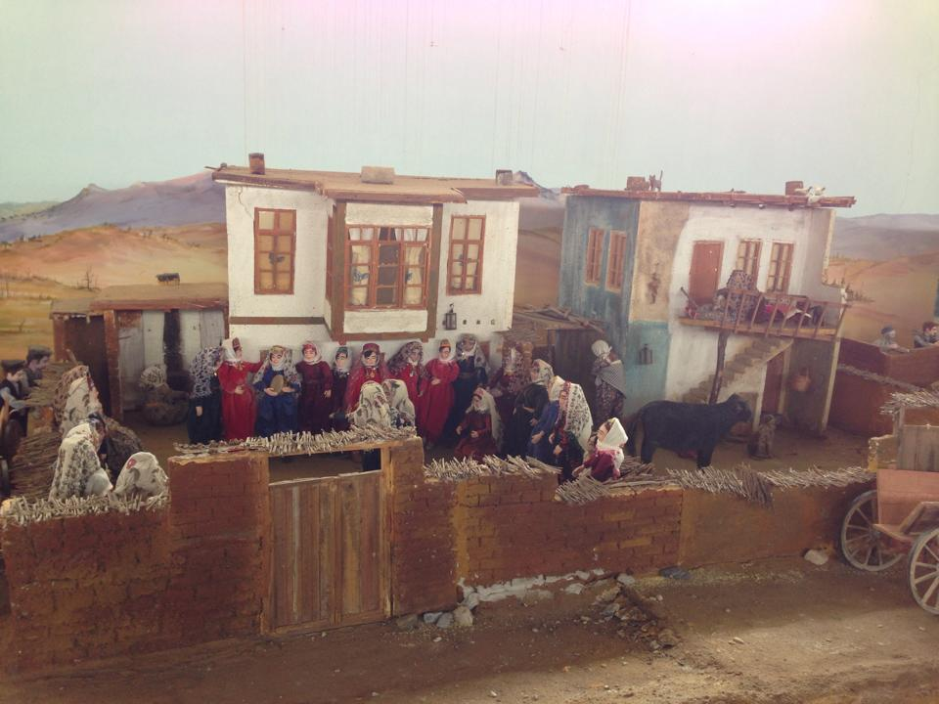
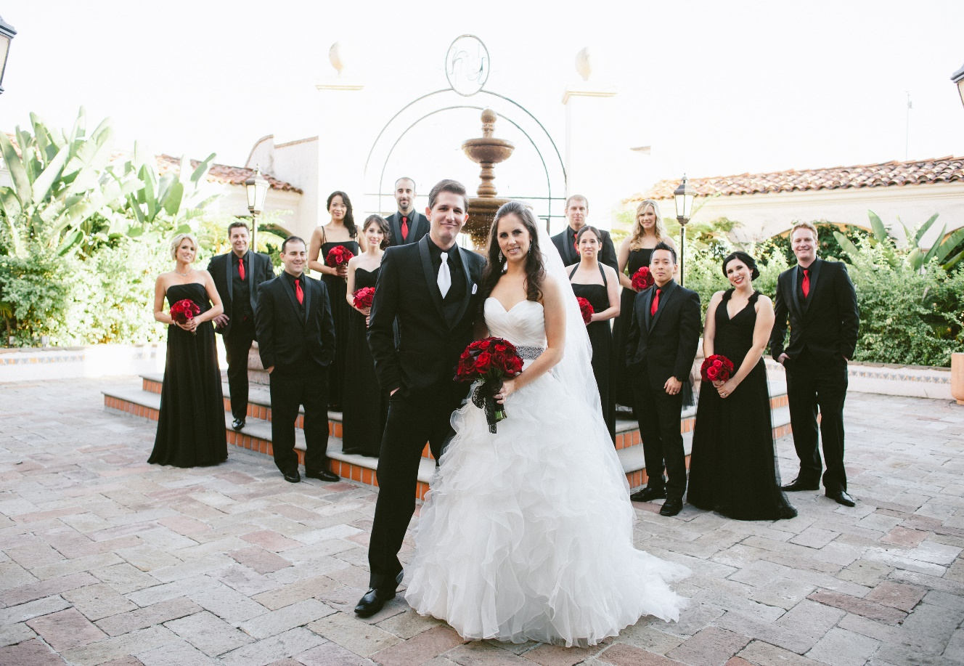
Wedding Ceremony
In the past, people used to do wedding ceremonies at the villages.
Today, they do wedding ceremonies at the special wedding saloons without old traditions.

Slide 2
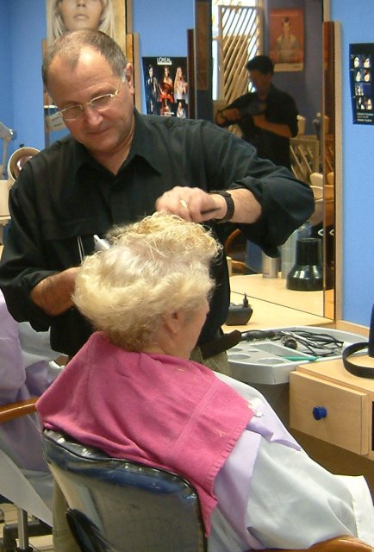
The Barbers
In the past, the barbers used to shave with special shaving knifes.
Today, the barbers don’t use them anymore.

Slide 3
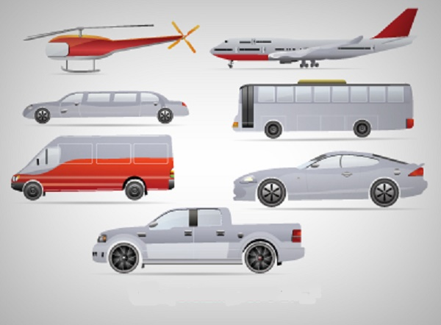
Transportation
In the past, people used some animals (cows,donkeys etc.) to transport someting to another place.
Now, they use better and easier ways for the transportation.

Slide 4
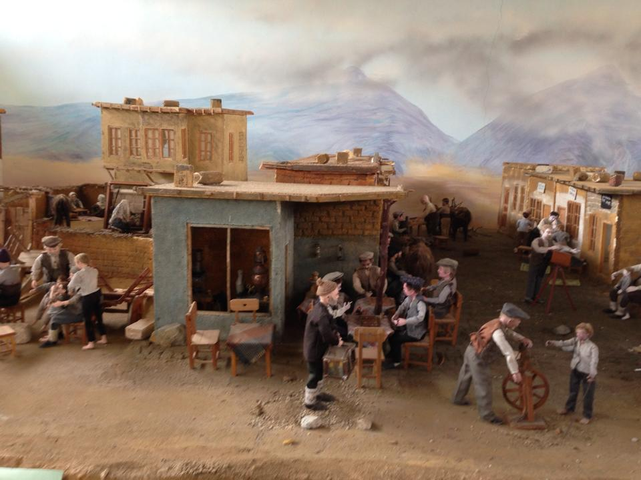
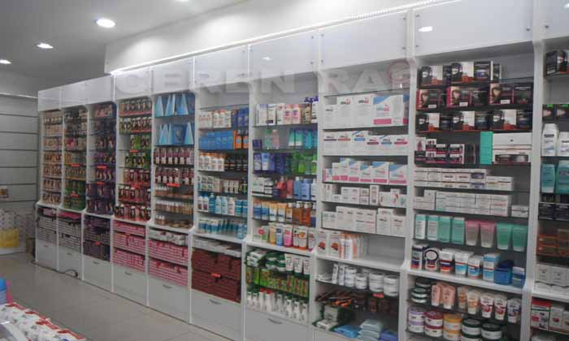
The Perfumes
In the past, the sellers of perfume were walking through the streets and selling home made perfumes.
Today, you can buy perfumes from the stores.

Slide 5
Just Do Butter!?
In the past, butter was made with wooden tools.
Today, butter is made by machines in the factories.

