Slide 1
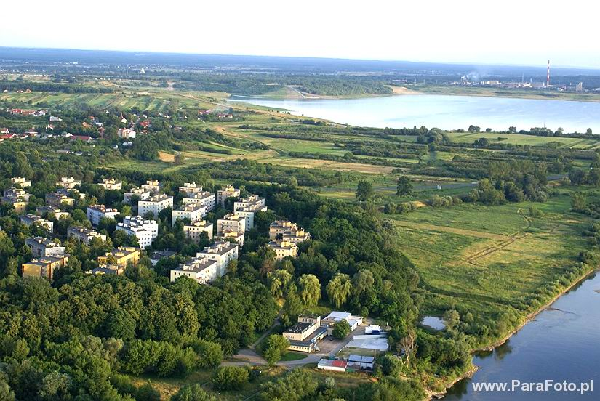
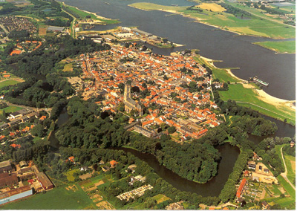
Our tour through Tarnobrzeg
Or: On similarieties between our two towns – we have more in common than it seems

Slide 2
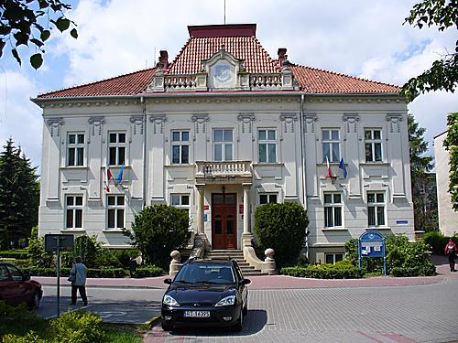
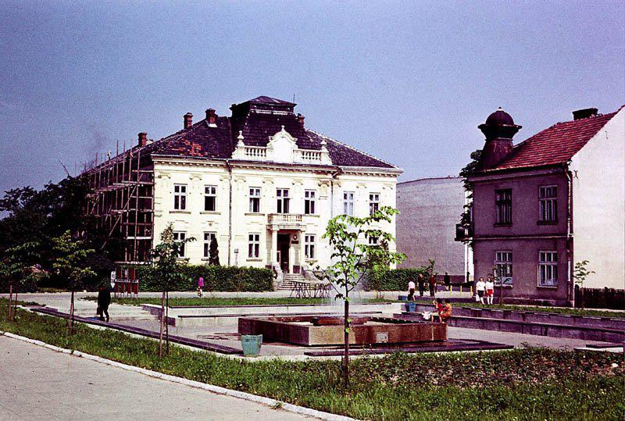
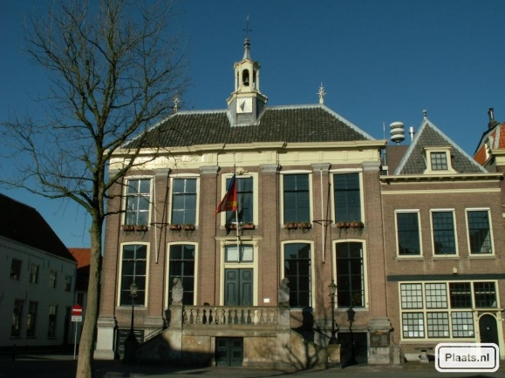
The council
Similar to councilhouse in Zaltbommel
Used as information point
In Tarnobrzeg used as councilhouse for the major
Old building of the local council
Old primairy school
1910

Slide 3
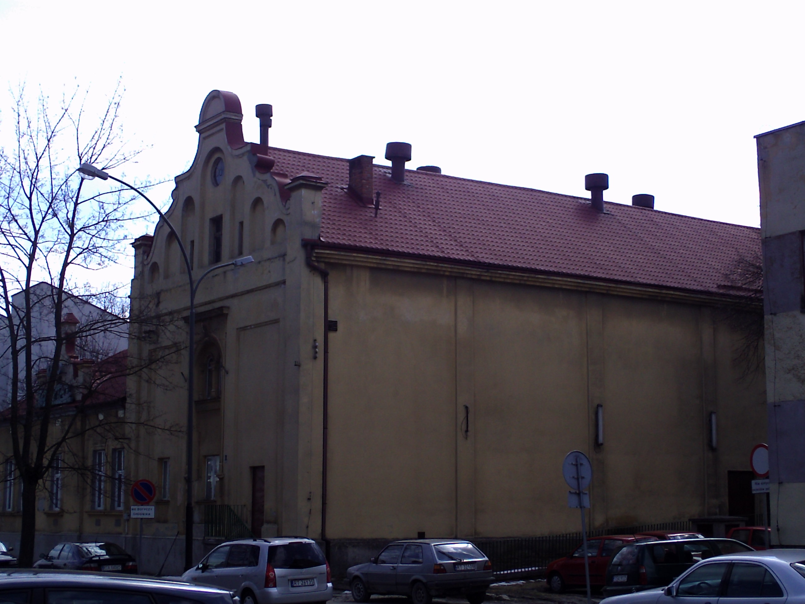
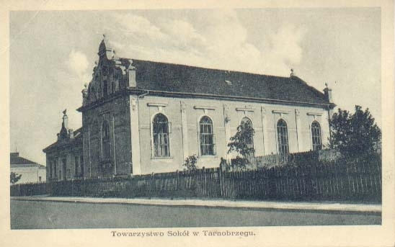
The ‘Wisla’ cinema
Used to be the building of the sports society.
It used to be a cinema for many years
Now it is empty and has no use… (shame)

Slide 4
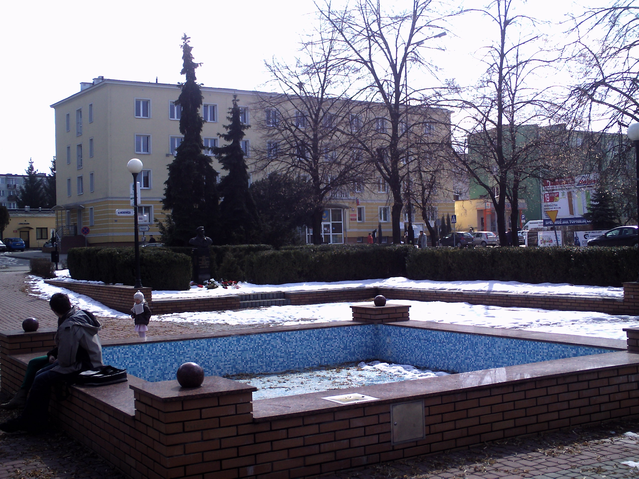
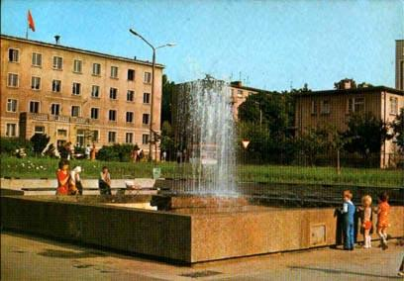
The fountain
This is a fountain that was built a couple of years ago. It’s a nice place to meet with friends. Mothers with children come here too. In the past it was like a central point in town.
Similar function to

Slide 5
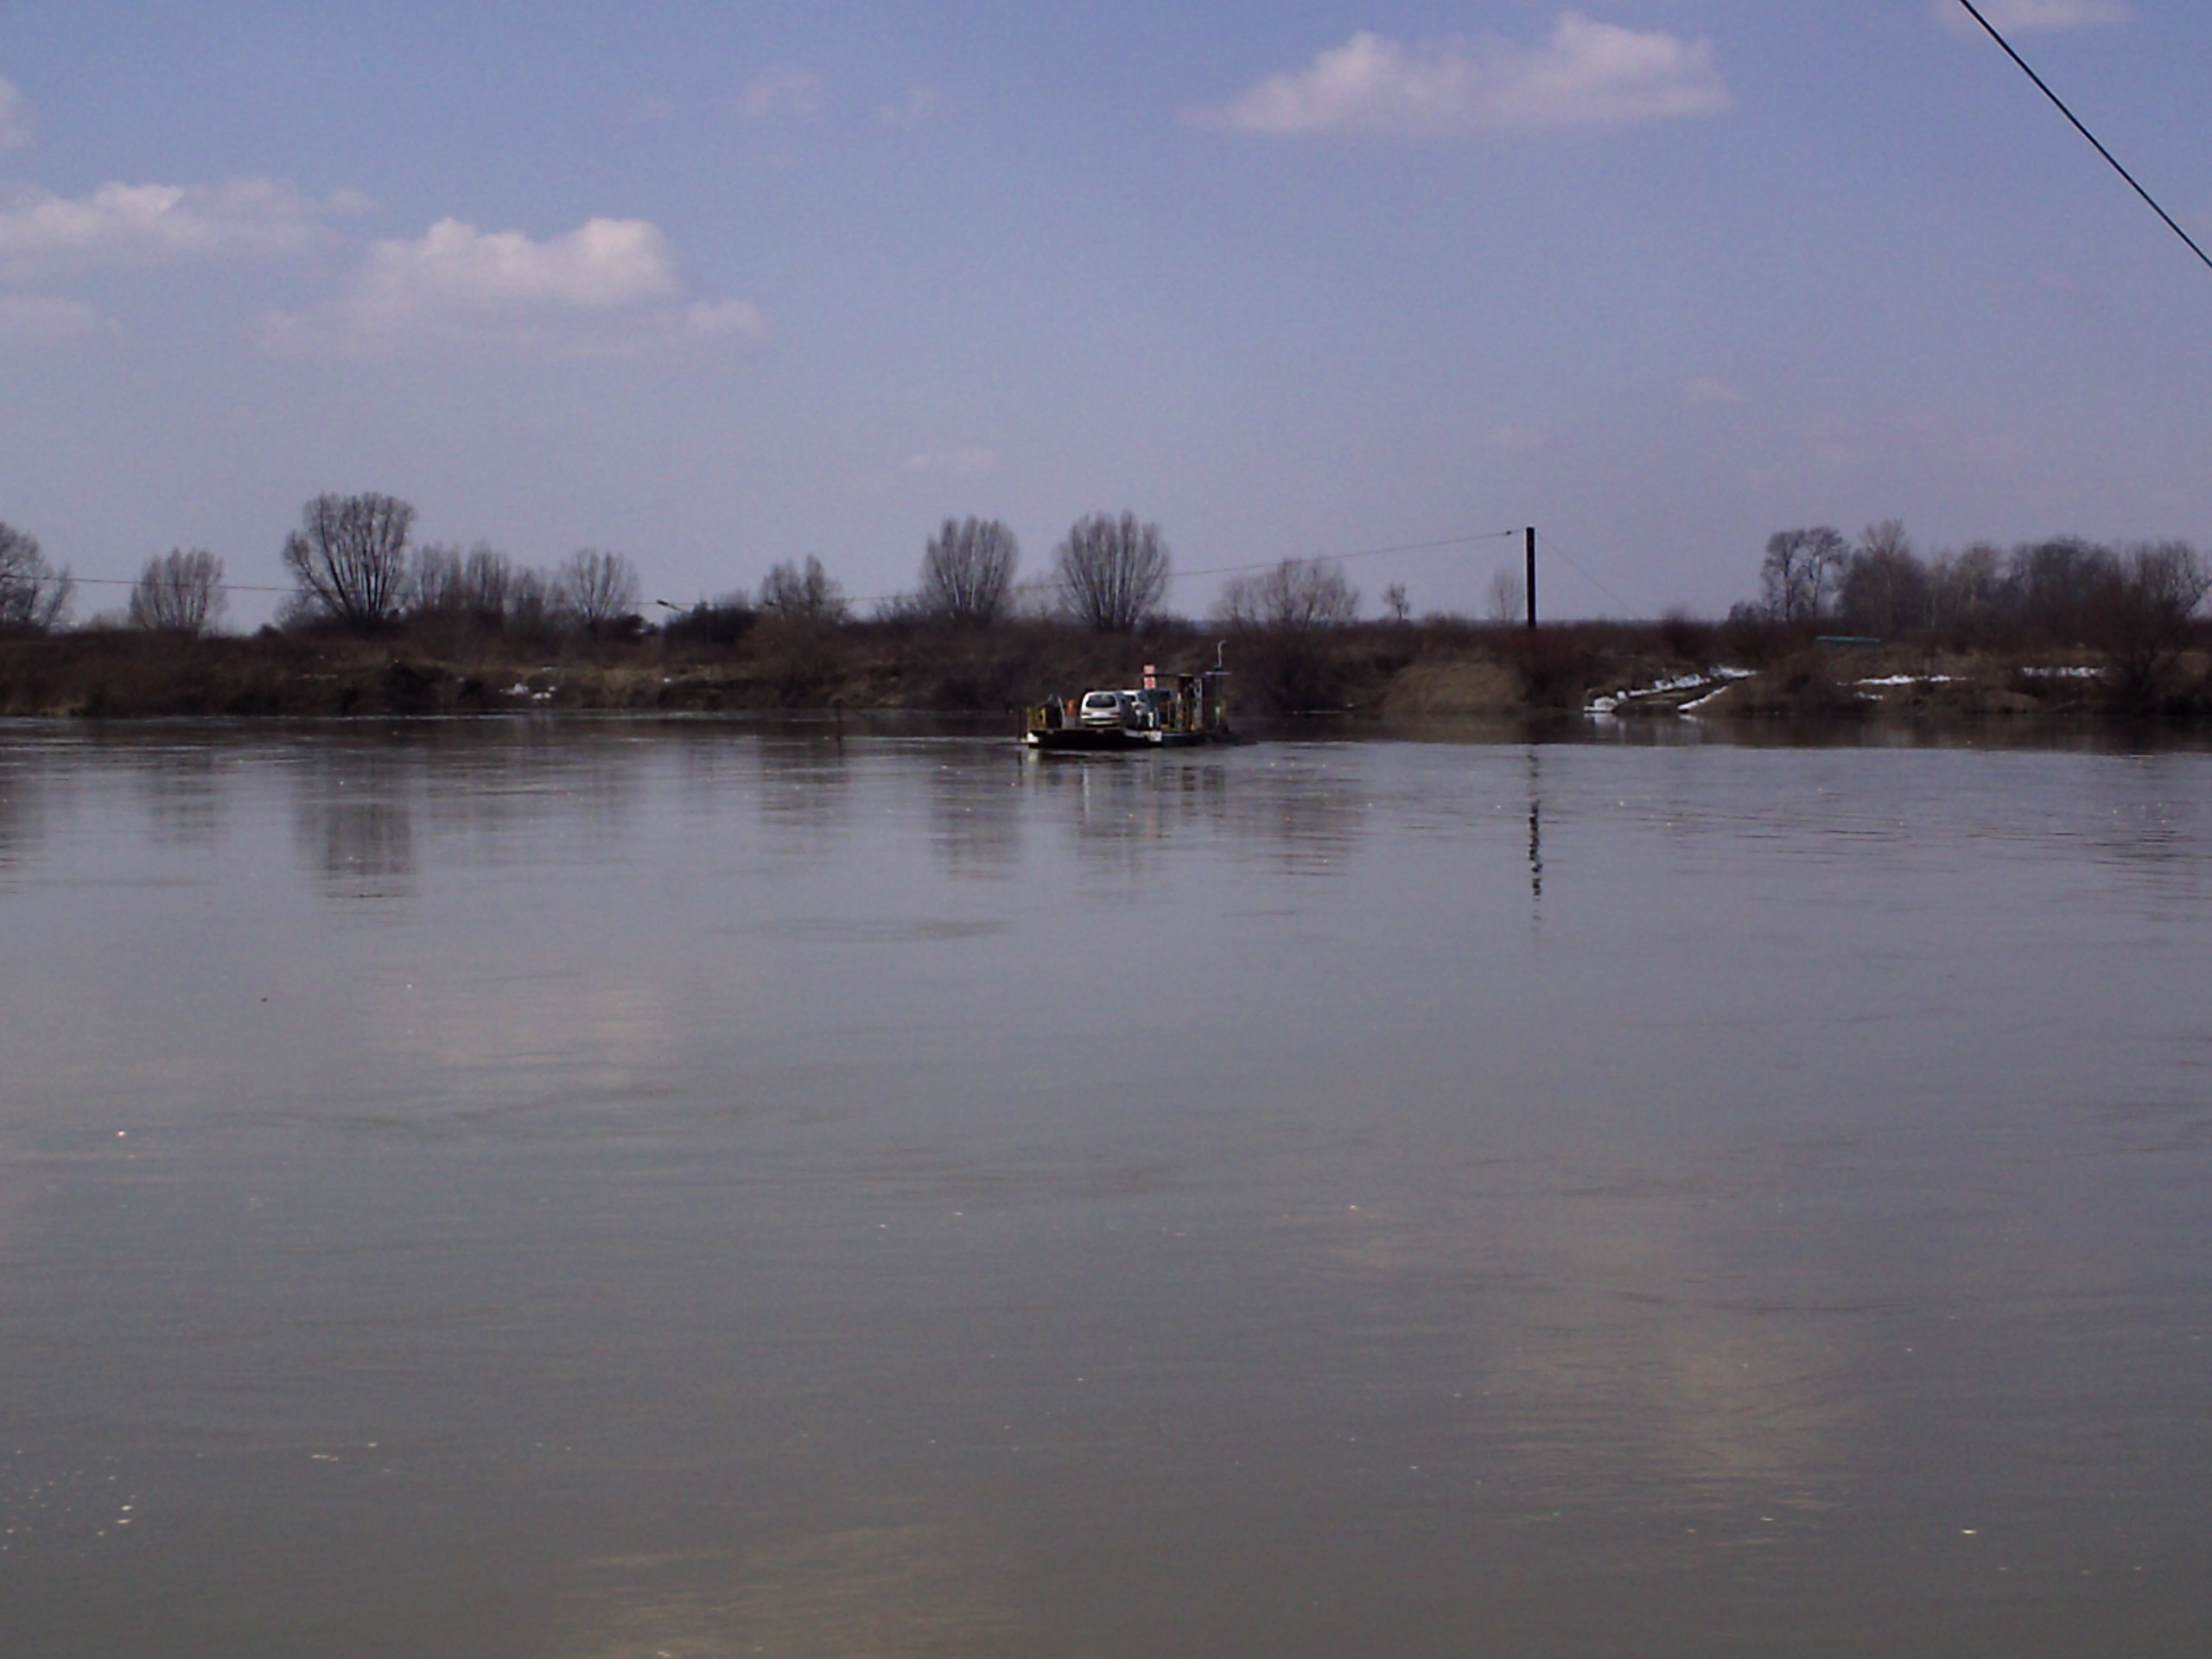
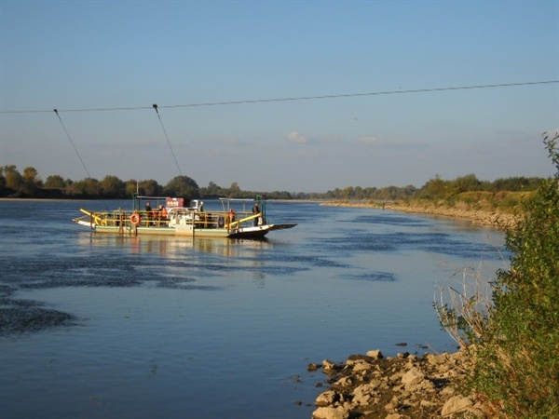
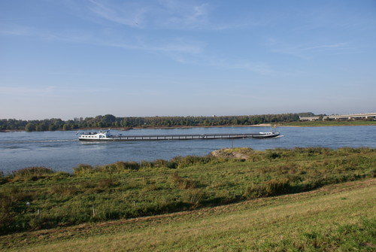
The Wistula River
The biggest river of Poland
There is a ferry
On the other side of the river, there is another province of Poland
Very similar to De Waal, in Holland

Slide 6
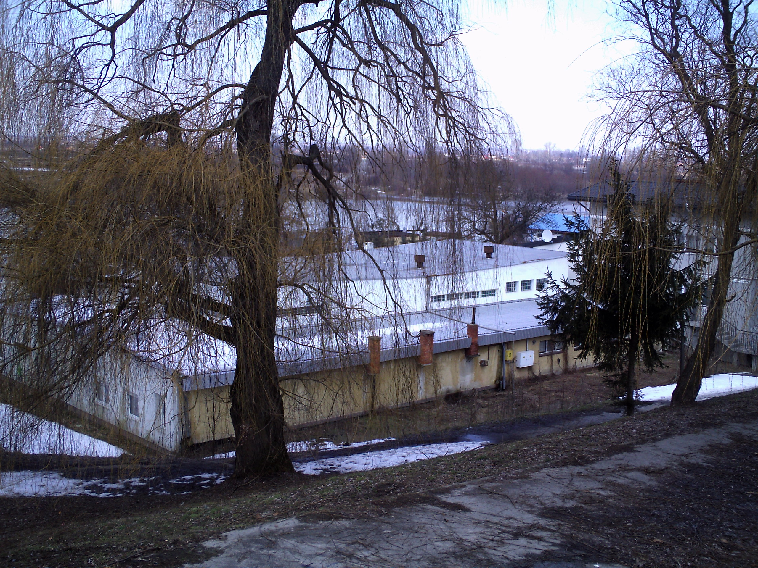
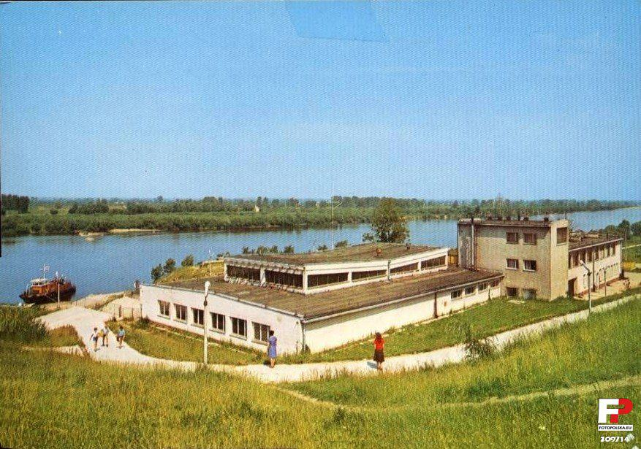
The riverside
The river used to be well seen from this point
Nowadays impossible because of the threes.
The building is a restaurant
People used the river banks for many purposes in both towns

Slide 7
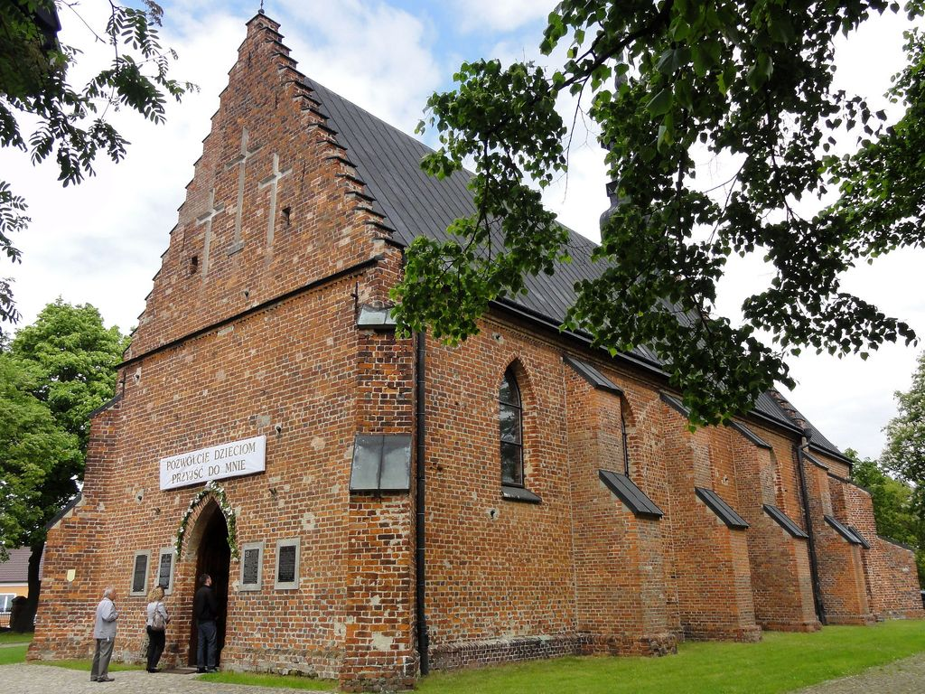
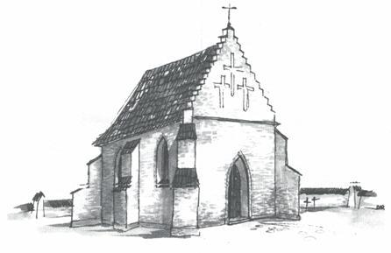
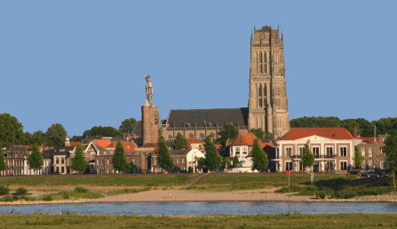
kościoł w miechocinie
This is a catholic church
Was built in 1160 in Gothic style
Oldest brick church in Poland
In Zaltbommet we have a big Cathedral – religion was important in the past

