Slide 1
Tendite in astra viri

Slide 2
Notes:
HERB/FOTA SZKOŁY/HERBU

Slide 3
That is our school’s logo.
It shows It’s patron, who is Hetman Jan Tarnowski.
He was Poland’s military officer in XIV centrury.
The inscription you saw at the beginning, „Tendite in astra viri” is our school’s motto.
It means: „Reach for the stars”.
And that is what we try to achieve in our school.
Notes:
TEKST WSTĘPU

Slide 4
Zespół Szkół Społecznych im. Jana Hetmana w Tarnobrzegu
Our school’s name is:
But It’s not only a school.
This is a place where history and myths meet modernity.
Where both lifelong tradition and fresh teenagers’ point of view matter.
A place of education, entertainment and a unique atmosphere .
Notes:
FOTA

Slide 5
LET’S START THE TRIP

Slide 6
THE CITY

Slide 7
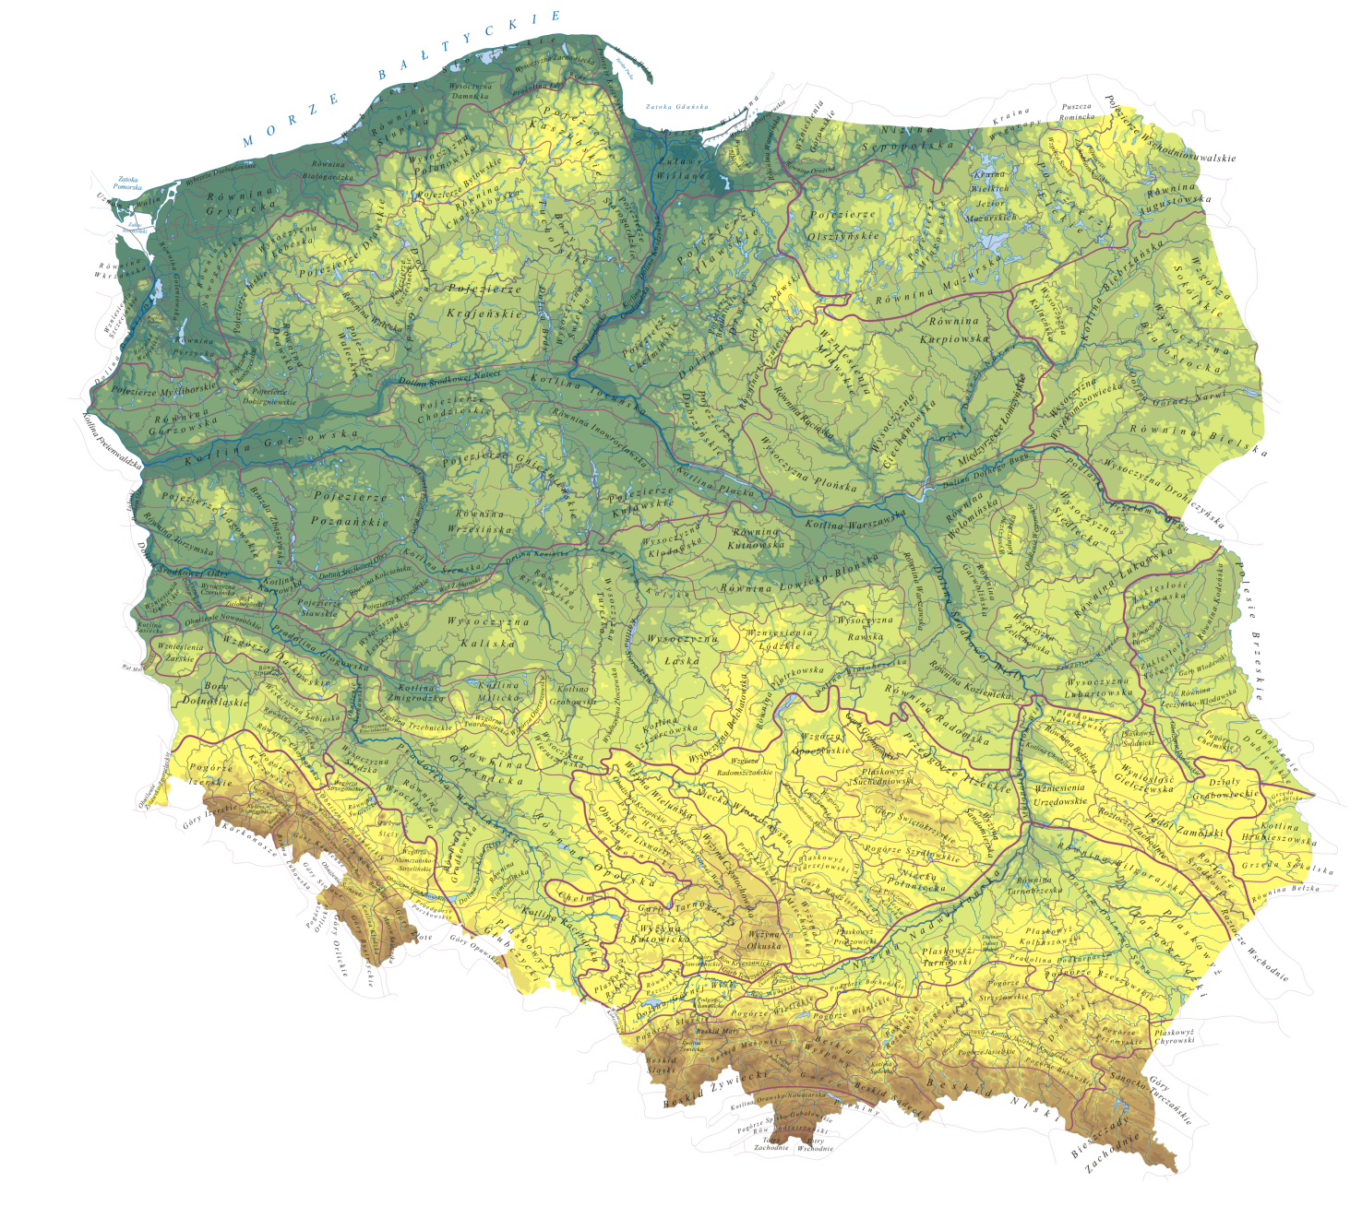
WE ARE HERE
Firstly, we are a school located in Tarnobrzeg, Poland.
Notes:
O TBG, GOOGLE MAPS,

Slide 8
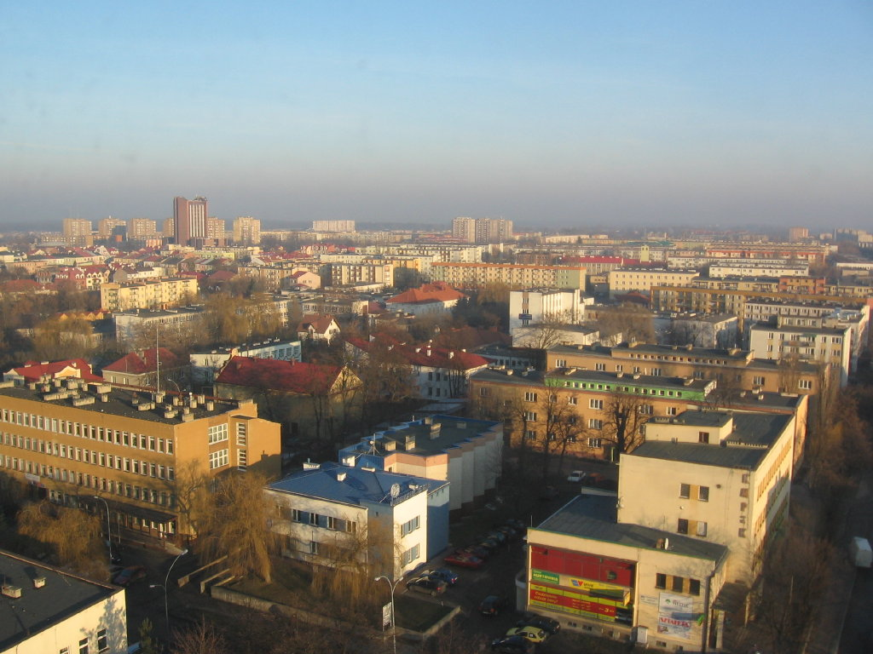
It has a population of about 50,000 people.
It is know for it’s huge sulfur mines.

Slide 9
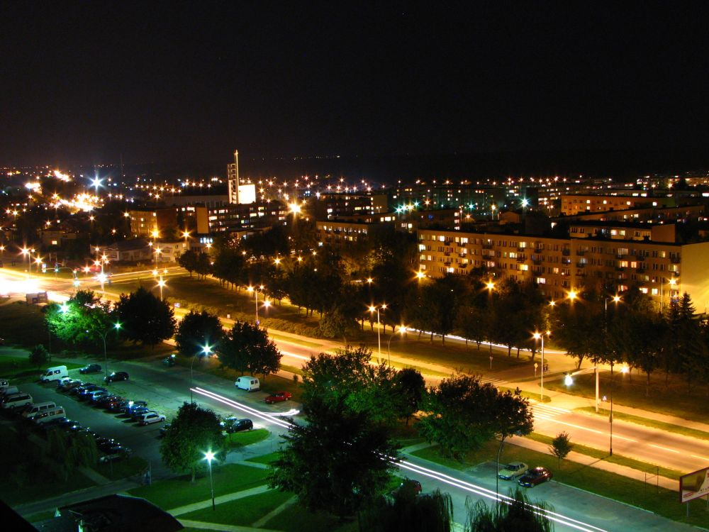
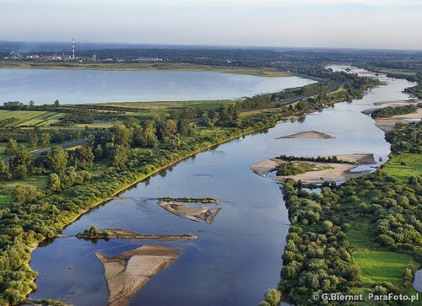
It lies on the shore of the river Vistula (picture at the bottom).
It’s the main river of Poland .
Vistula starts high in the mountains and after crossing Poland, falls into the Baltic see.

Slide 10
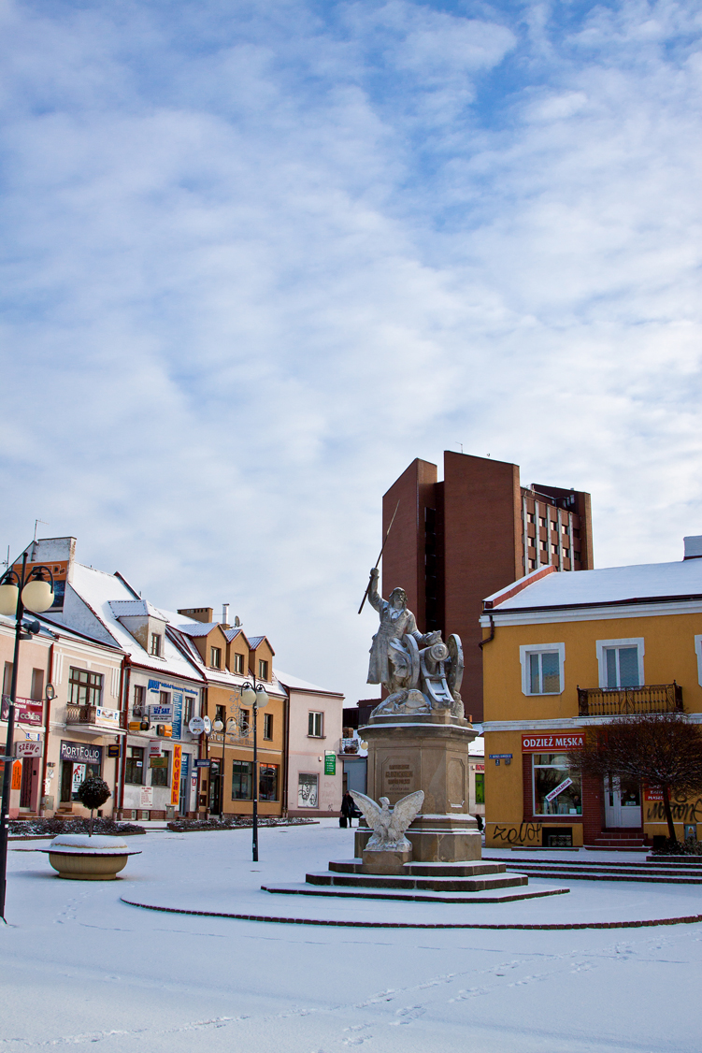
Tarnobrzeg was founded in the XIV century by the Tarnowski family .
Yes, it is the family from which our patron comes from.
In the close neighbourhood of our school is the city’s main square with a war hero’s Bartosz Głowacki statue(to the left).
Notes:
FOTA RED SQUARE

Slide 11
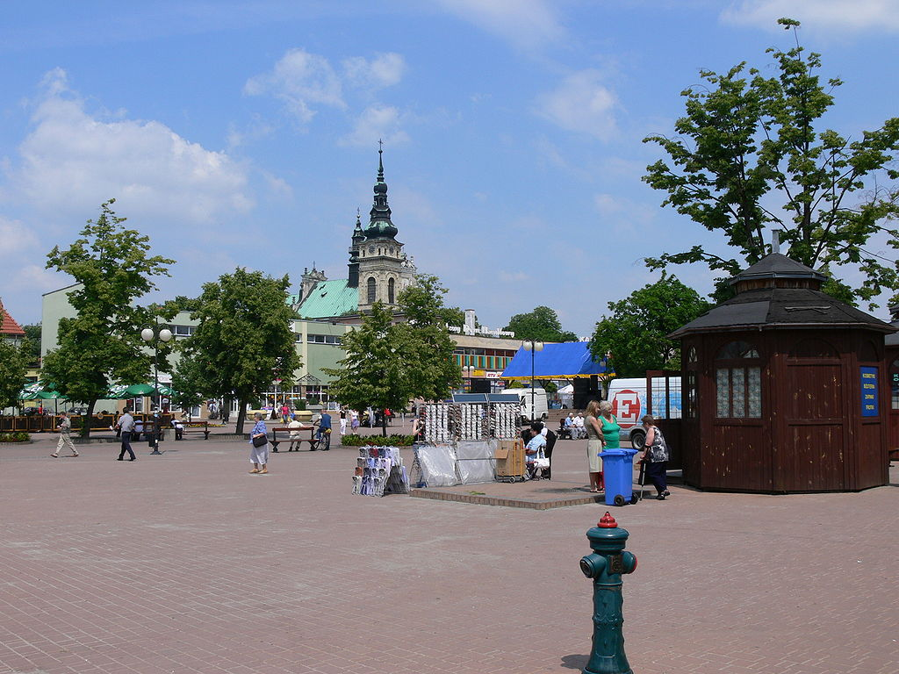
That is the main square, named after the war hero, but it’s commonly called „red sqaure”.
Notes:
O red square (głowacki foto)

Slide 12
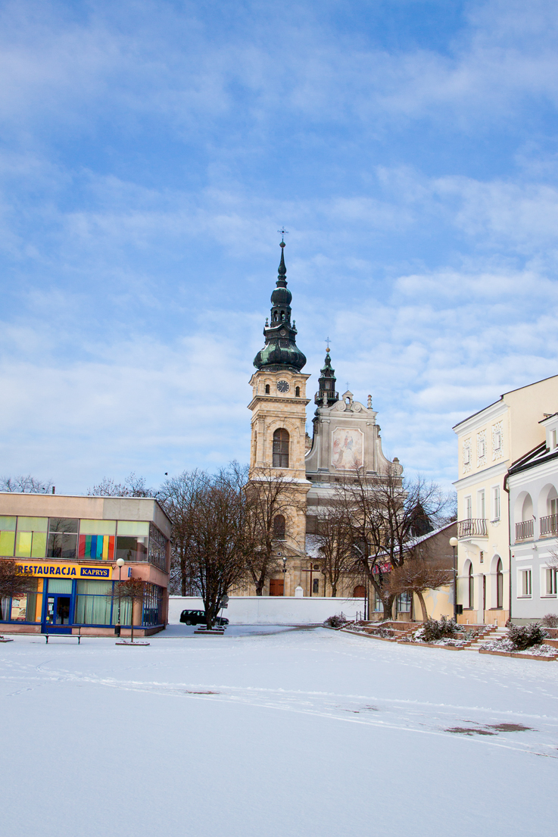
That is the symbol of Tarnobrzeg,the Dominican Monastery from XVII century.
As you can see, it is located close to the „red sqaure”.
Our school is just behind the corner.
Notes:
Kościół i jego historia

Slide 13
The schooL

Slide 14
Our present location on Dominikanska Street.
In 1998/1999 our school transfered to this, much more comfortable, location in the centre of the city’s old town.
Notes:
BUDYNEK(korytarze)

Slide 15
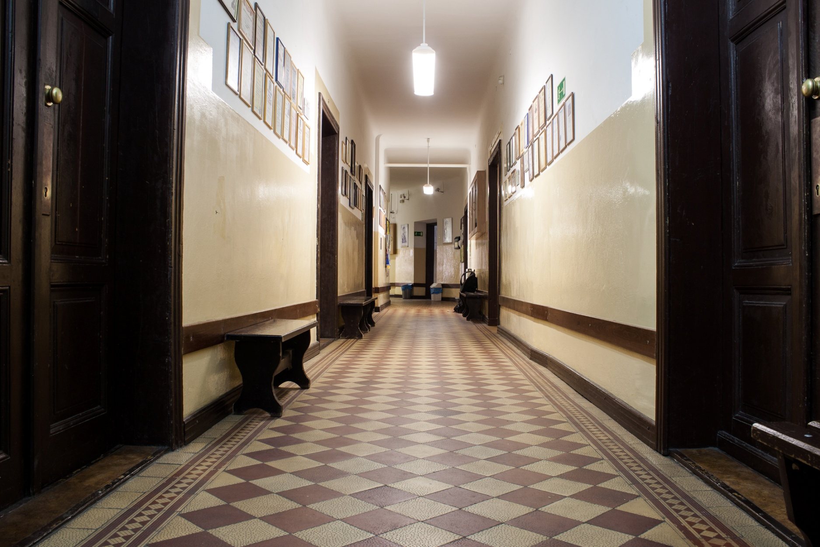
WELCOME IN OUR SCHOOL
Notes:
BUDYNEK(korytarze)

Slide 16
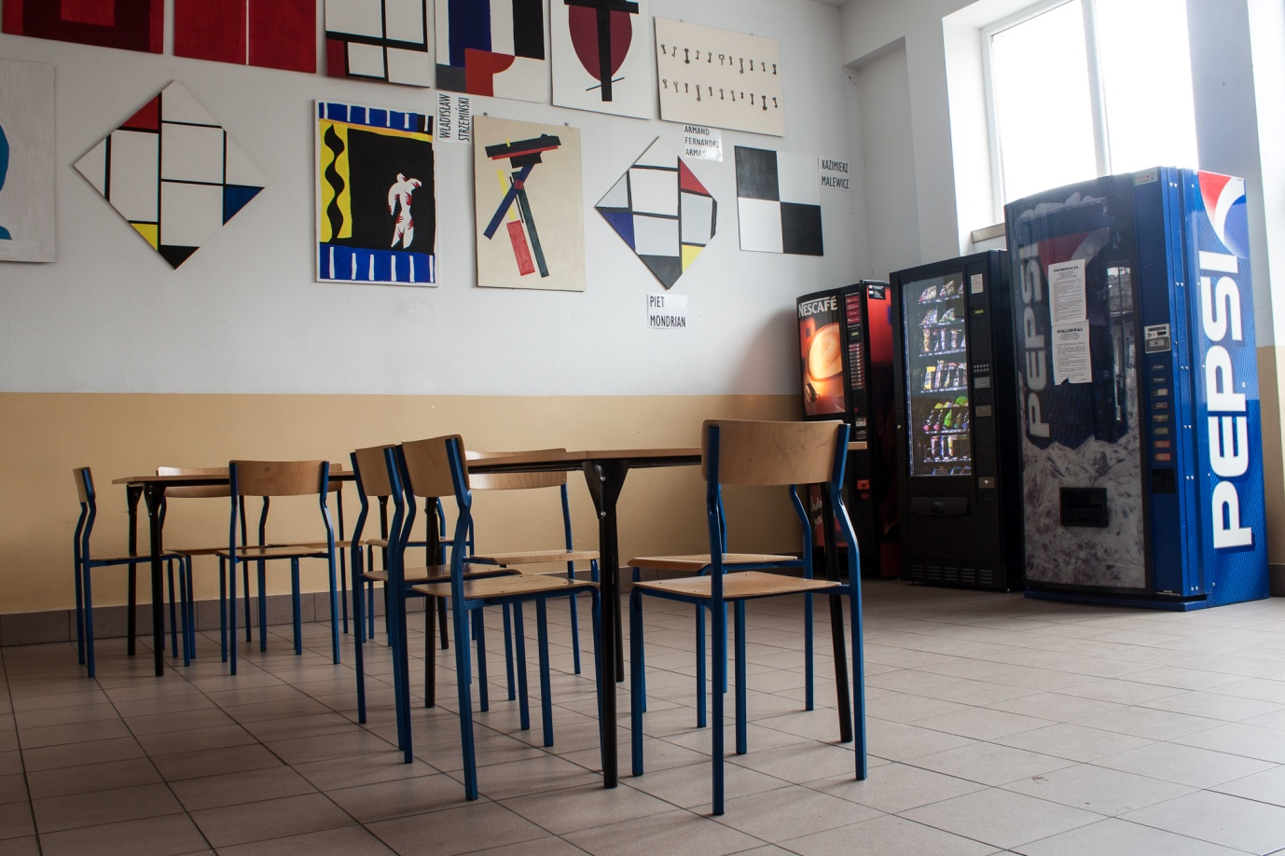
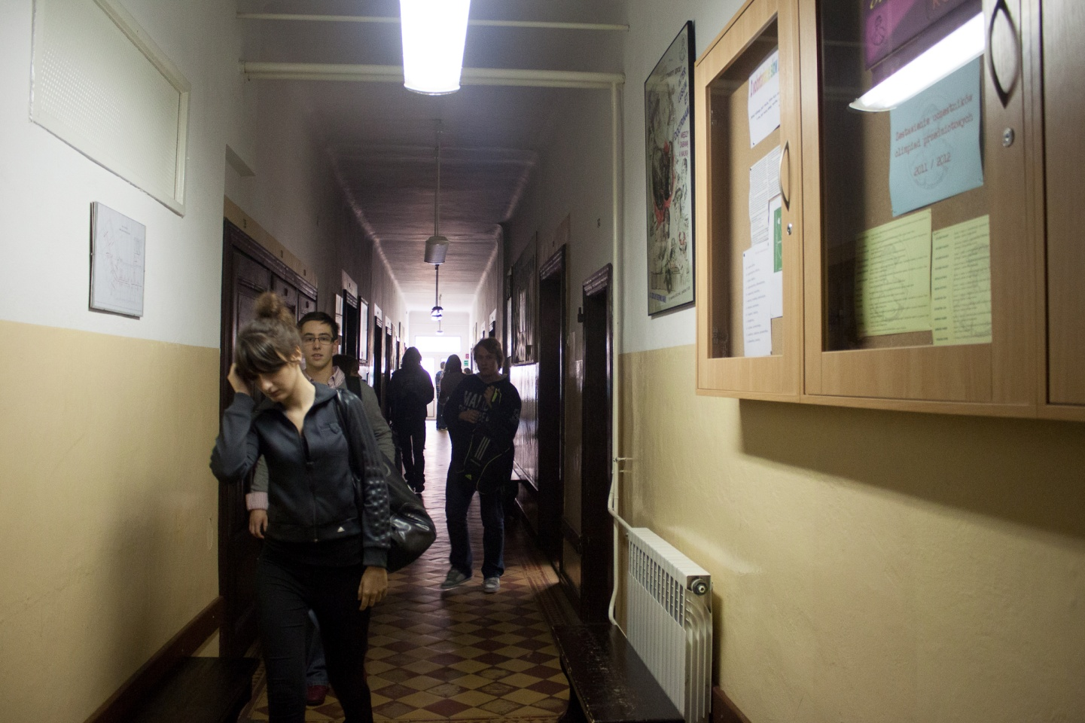
To the left: our main hall
To the right: the hallway.
Notes:
BUDYNEK(kafeteria)

Slide 17
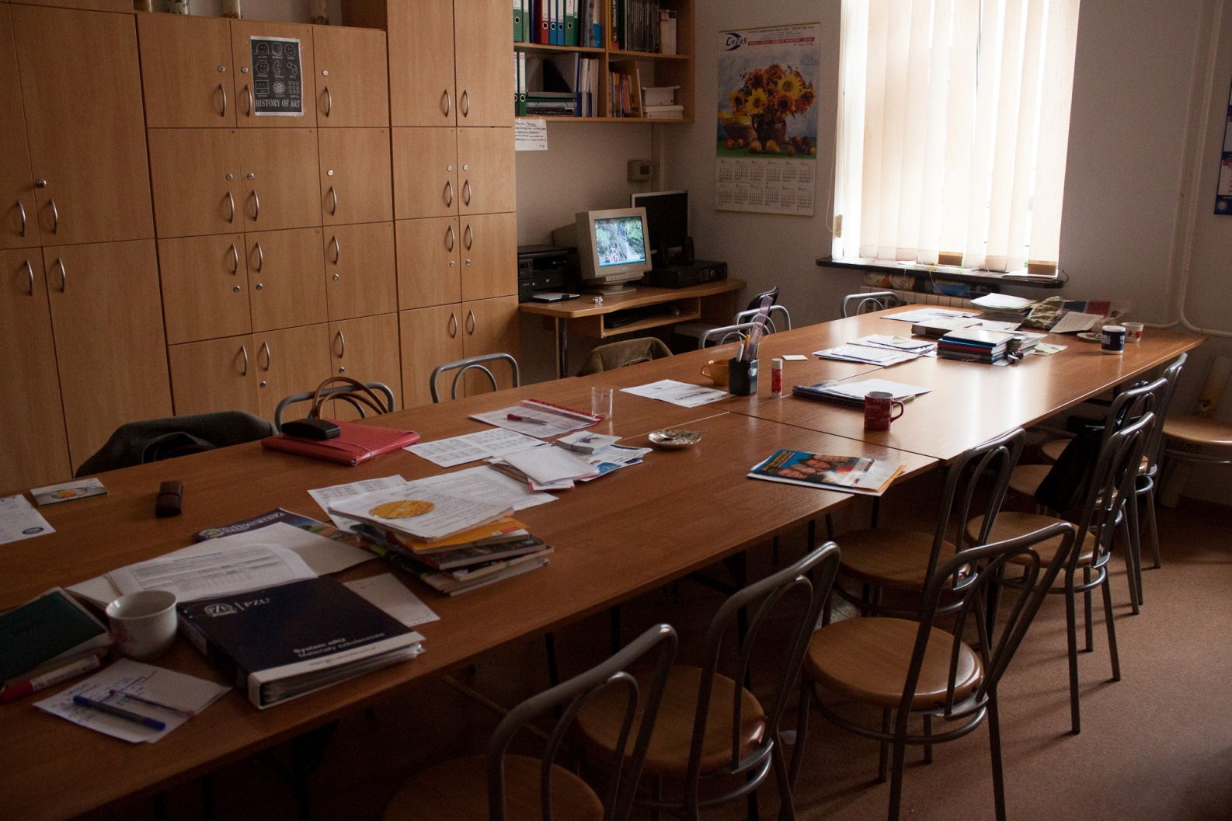
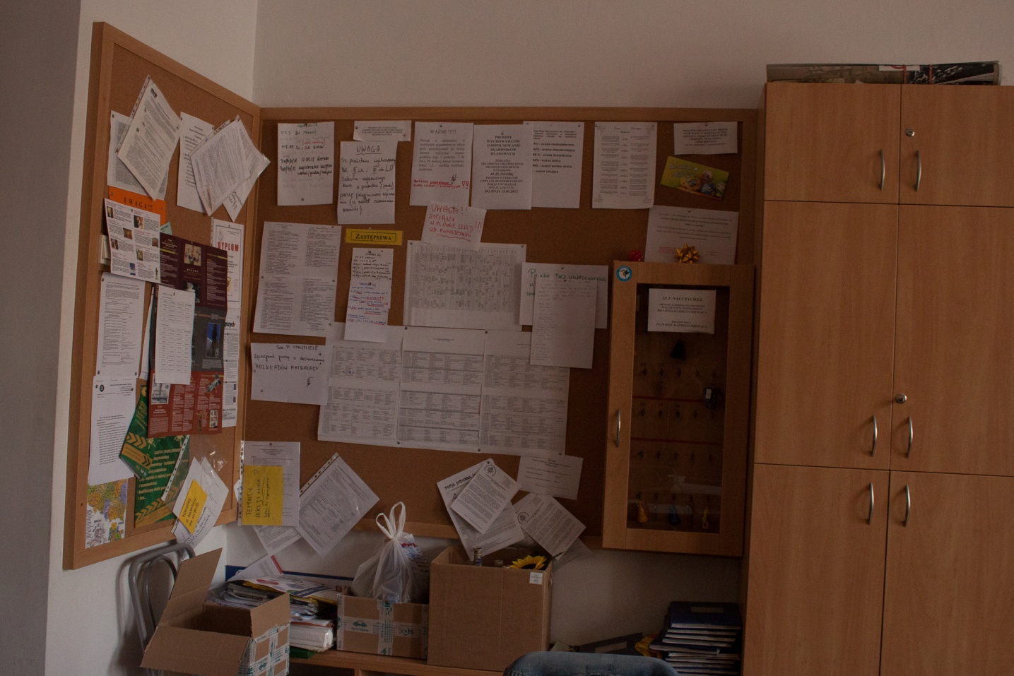
The teachers’ room
Notes:
BUDYNEK(pokój nauczycielski)

Slide 18
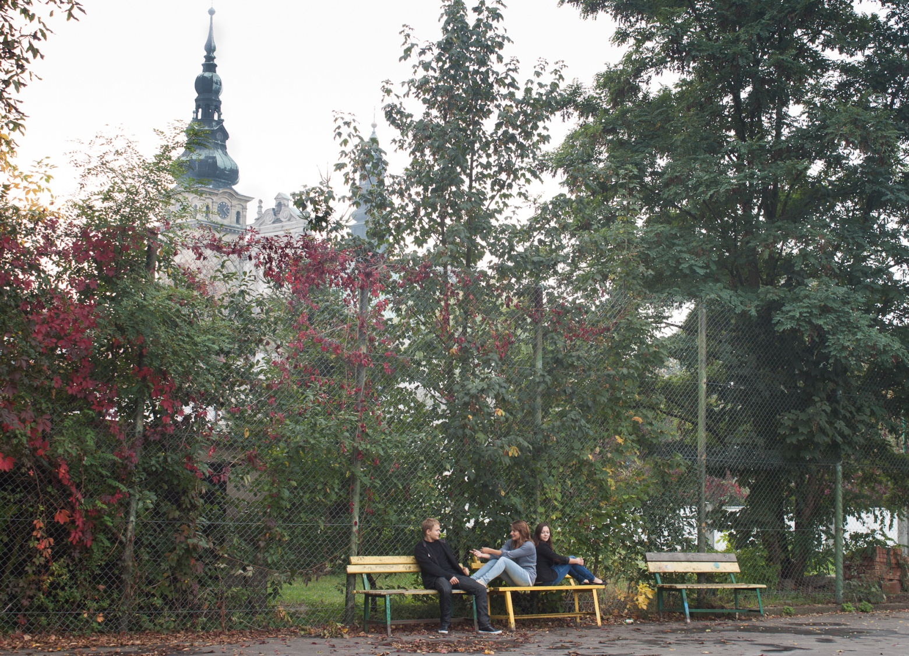
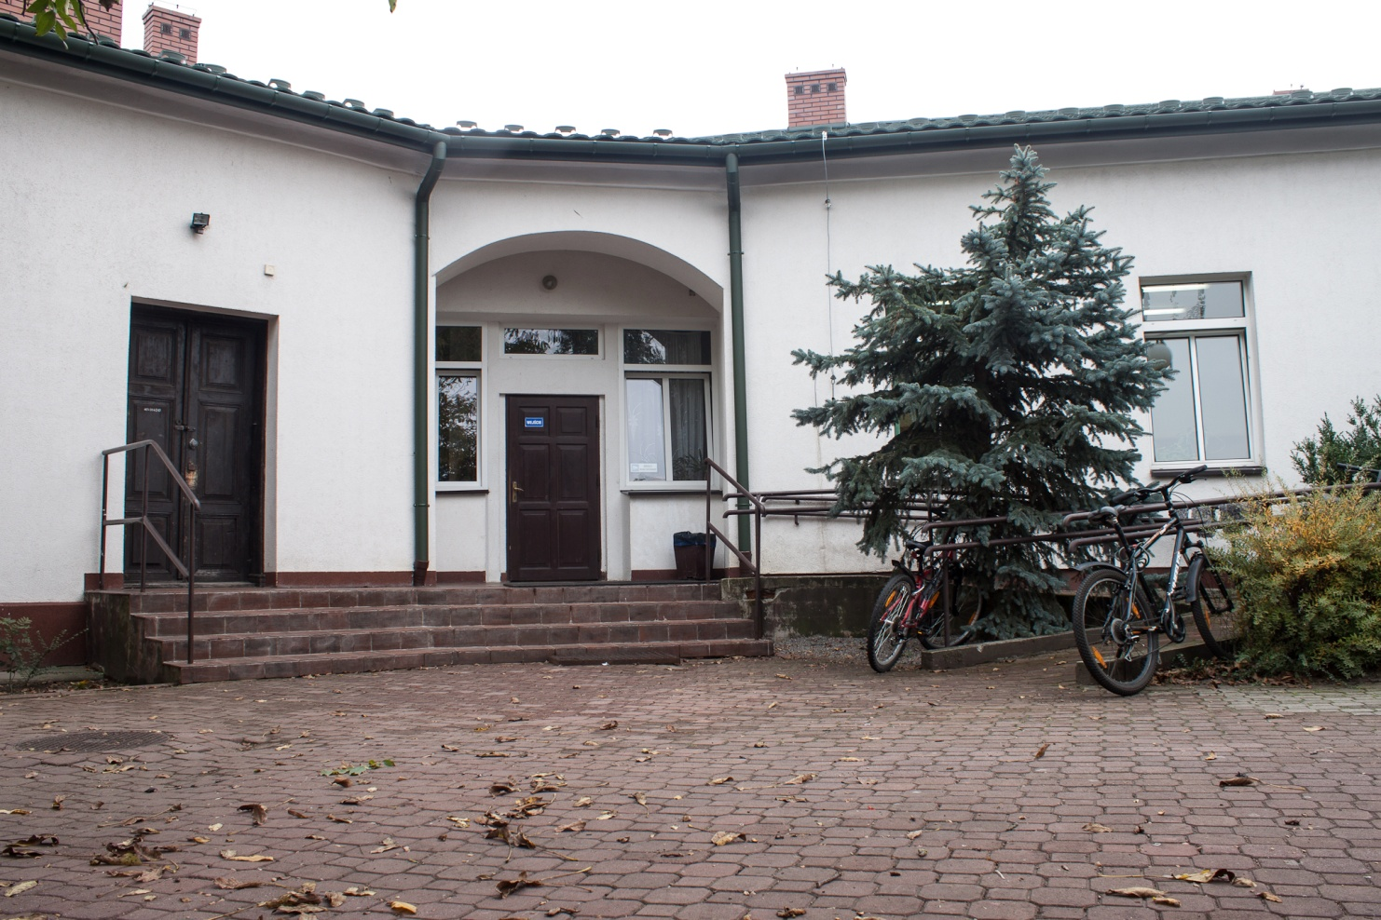
To the left: our school’s backyard
To the right: the back entrance
Notes:
BUDYNEK(hol/tylne wejście/bosiko)

Slide 19
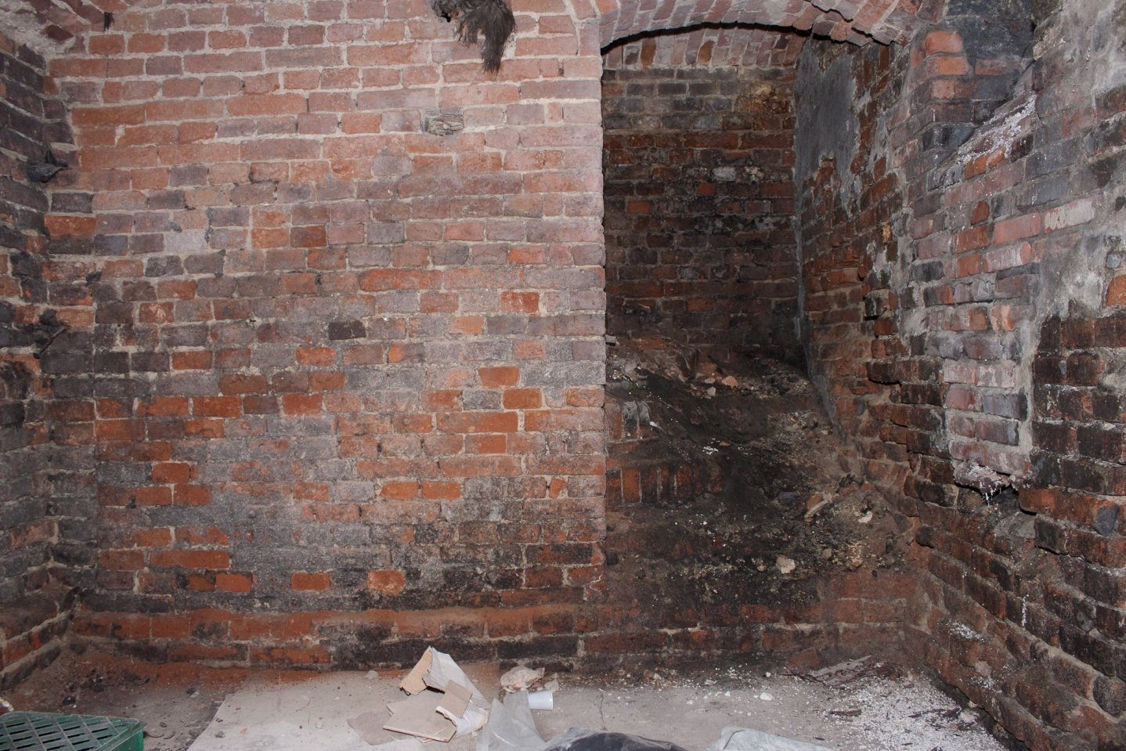
That’s our school’s dungeon, pretty creppy, isn’t it?
Thare are many legends regarding it that are tied to the rich history of our school’s bulding.
Notes:
BUDYNEK(piwnica) i historia

Slide 20
THE HISTORY
Notes:
HISTORIA

Slide 21
After the year 1989, due to many reforms of Polish educational system, a lot of private schools started to be founded all over our country.
The idea appeared also in Tarnobrzeg, where a group of ambitious teachers from different schools decided to start the Tarnobrzeg’s Common Educational Society.
In 1990, with the help of a few future students’ parents and the local administration, they established the First Social High School under the patronate of hetman Jan Tarnowski, commonly called „the Hetman”.
Notes:
HISTORIA i MOŻE FOTA

Slide 22
In the beginning, the school had to fit in only one wing of the ground floor in the building where nowadays the Tarnobrzeg’s Agency of Regional Development is located.
It had been there until 1998/1999.
The Hetman’s building is located on Dominikanska Street and has long and interesting history.
Notes:
HISTORIA I MOŻE FOTA(może już początek historii budynku)

Slide 23
The Hetman’s building used to be a part of Tarnowski countship’s properties and served as a stable.
This the reason why our patron is hetman Tarnowski of Leliwa arms.
To the right: Tarnowski’s arms, Leliwa.
Notes:
HISTORIA BUDYNKU FOTA

Slide 24
Then, the district court was moved in there. The dungeon we showed you before earned it’s chilling tales from that period.
But enough history, let’s move to more up-to-date events.
Notes:
HISTORIA FOTA

Slide 25
THE EDUCATION

Slide 26
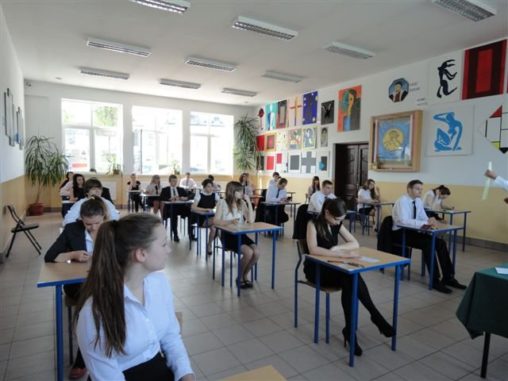
That is theExam of Maturity, or in Polish: matura
In Poland, at the age of 16 you start a 3-year high school or a vocational school ended with Exam of Maturity – a big test wchich enables you to go to university.

Slide 27
Most students choose the first option which we called LICEUM.
In public institutions you decide on your educatinal direction, you can choose, for example, math and physics or art, and you are given a particular schelude.
Although you have you major classes, you have to learn all the subject in general.

Slide 28
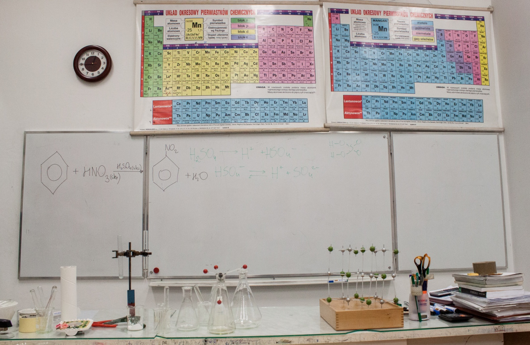
To the left: Our chemistry classroom
Our school is a private, so you have to pay fee.
But, schedules are more individual.
We also choose major subjects, but can mix all categories, for example, phisics and art.

Slide 29
Chosing you own major subjects is impossible in public schools.
In our school you concentrate mostly on your chosen subjects, learning just basics from others
In the last, third year of LICEUM education you onlly have major calsses which allows you to foucus on material that you will need for matura exam

Slide 30
To the left:
Our dissection classroom
Thanks to this system, we aren not „over-packed” with knowledge and classes and we are also better prepared for exams.

Slide 31
THE FUN PART

Slide 32
Everybody knows that school is not only an educational institution.
That is why we don’t forget to have fun in our school.
We organize many discos, ski camps, trips, festivals and other events.
Let’s see some of them!

Slide 33
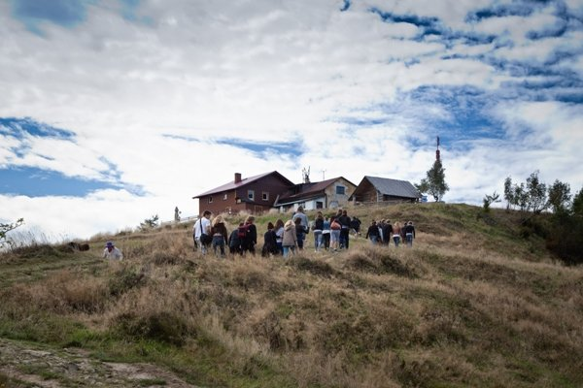
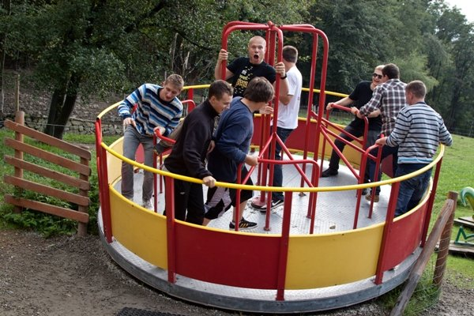
The trips

Slide 34
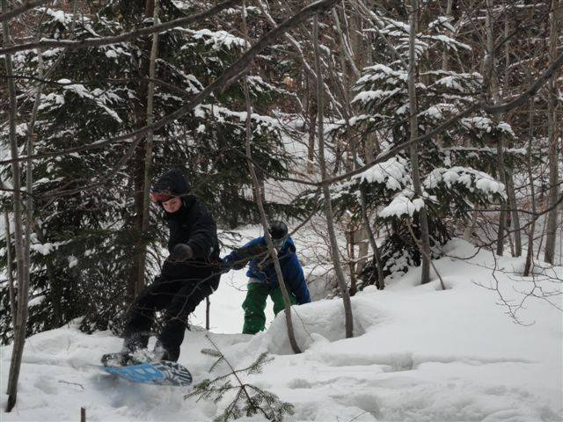
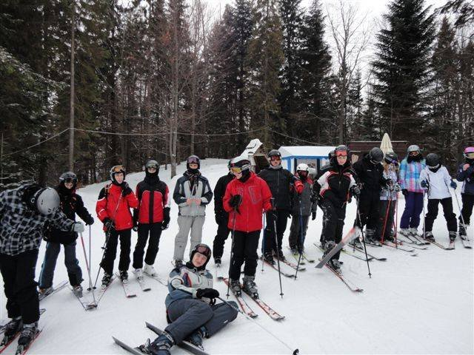
The Ski Camps

Slide 35
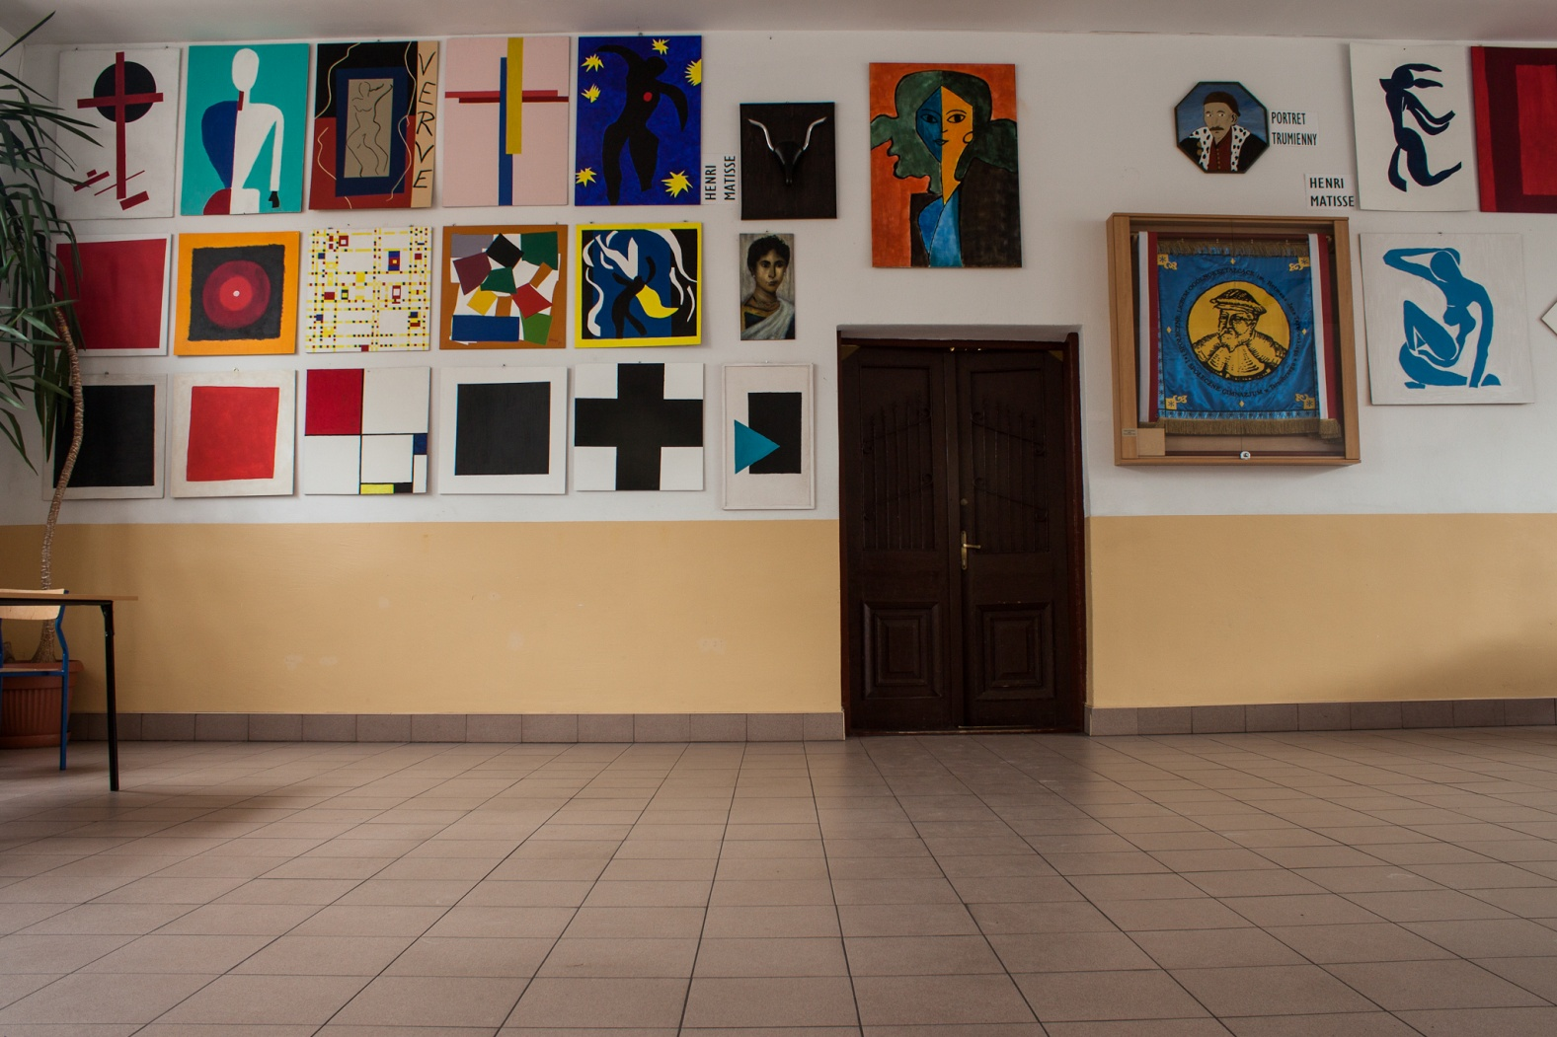
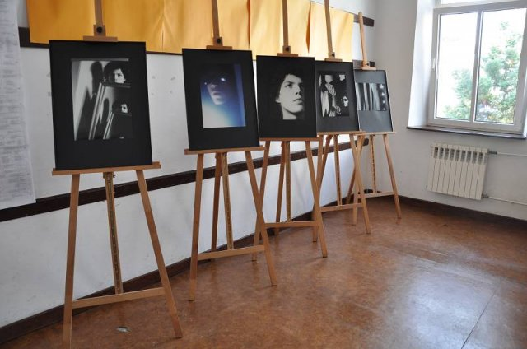
The festivals

Slide 36
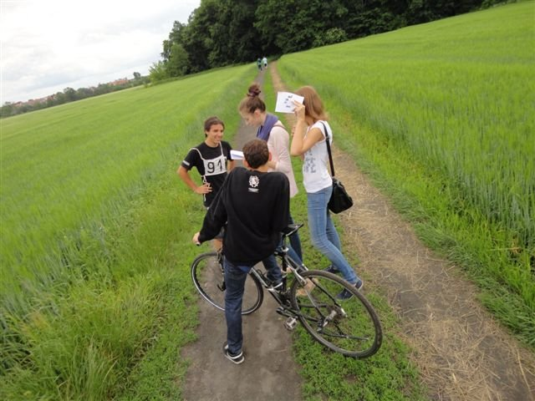
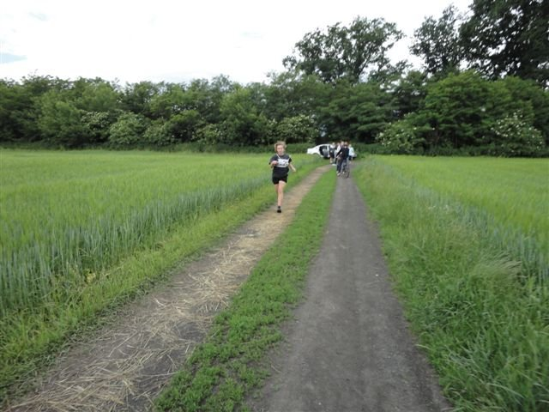
The sports

Slide 37
And more!
We also organize:
Music and poetry concerts,
Cabartes,
Talent shows,
Fashion shows,
Biology & Chemistry Nights.

Slide 38
Logo of the newspaper.
We also have our internet school newspaper where our students post almost everything they want.
It is called „Goniec Hetmański” which means „Captain’s messenger”.

Slide 39
THE achievements

Slide 40
You already know much about our school and you must be wondering: „How does it all turns out?”
And the answer is:
AWESOME

Slide 41
Our schools was announced to be the best in our home city.
It was also 4th in our province.
And 114th in Poland!

Slide 42
Last years exam of maturity turned out to be really good for our students.
The mathematics maturity exams resoults placed our school on 1th position in our province.
And, on 5th position in Poland.

Slide 43
Lots of our students takes part in knowledge contest.
Last years four of them had won in subjects: Math, History, Geography, Poetry and Art.

Slide 44
We have a lot of scholarship holders in our school too.
The scholarships are both funded by our schools and by our Ministry of Education.

Slide 45
Thank you for listening.
And remember

Slide 46
Tendite in astra viri!

