Slide 1
TURKEY / TÜRKİYE

Slide 2
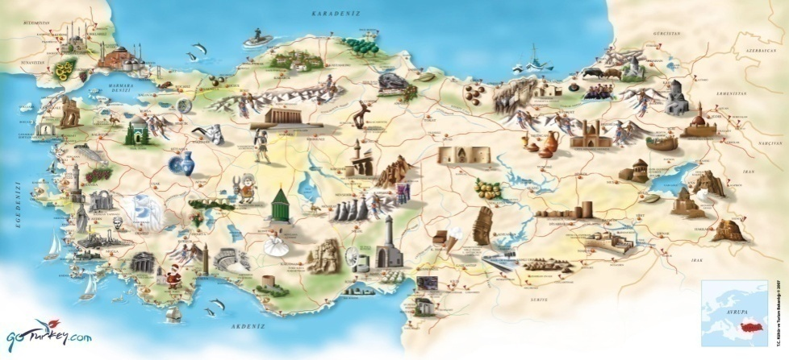
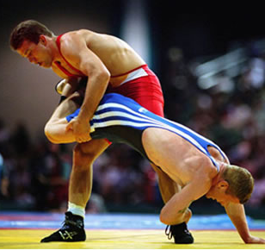
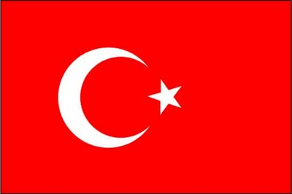
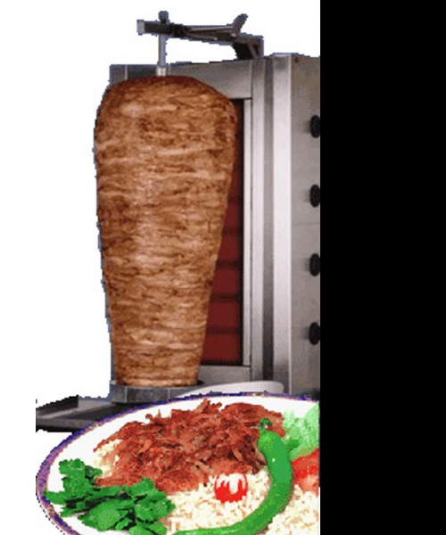
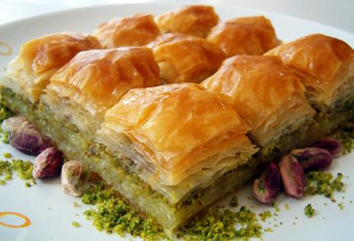
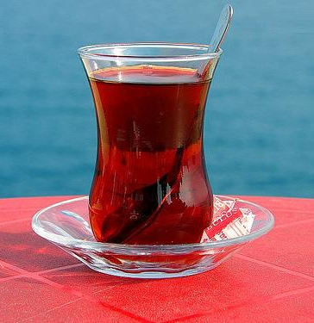
Welcome to
Turkey
Turkey

Slide 3
Turkish Flag and Presidential Seal
The Flag of Turkish Republic
White half moon and star on the red background.
The Presidential Seal
The 16 stars represent the 16 Turkish states in our history.

Slide 4
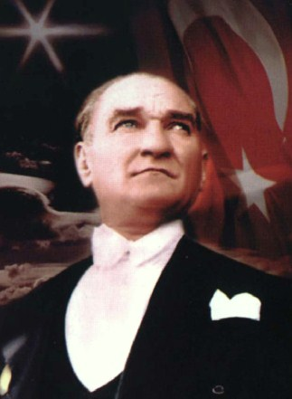
Mustafa Kemal ATATÜRK
1st President of Turkey ( 1881 – 1938 )

Slide 5
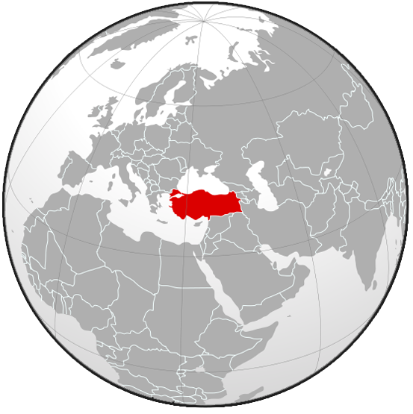
Where is Turkey on Map?
Turkey functions as a bridge between Asia and Europe

Slide 6
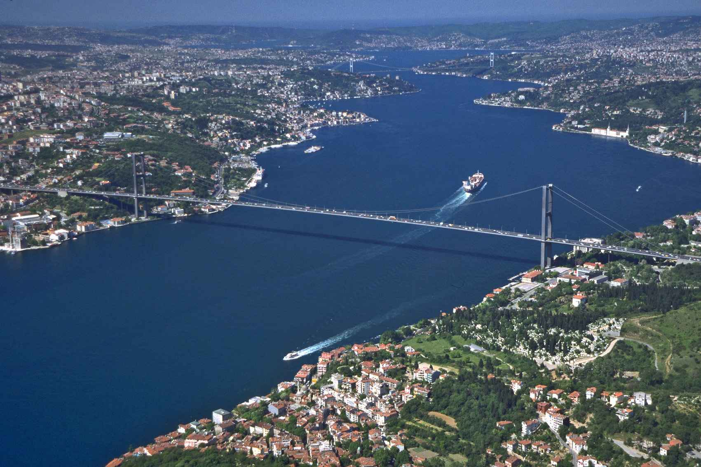
Turkey is a gateway between Europe and Asia. The European and Asian sides are divided by the Bosphorus (İstanbul Boğazı).

Slide 7
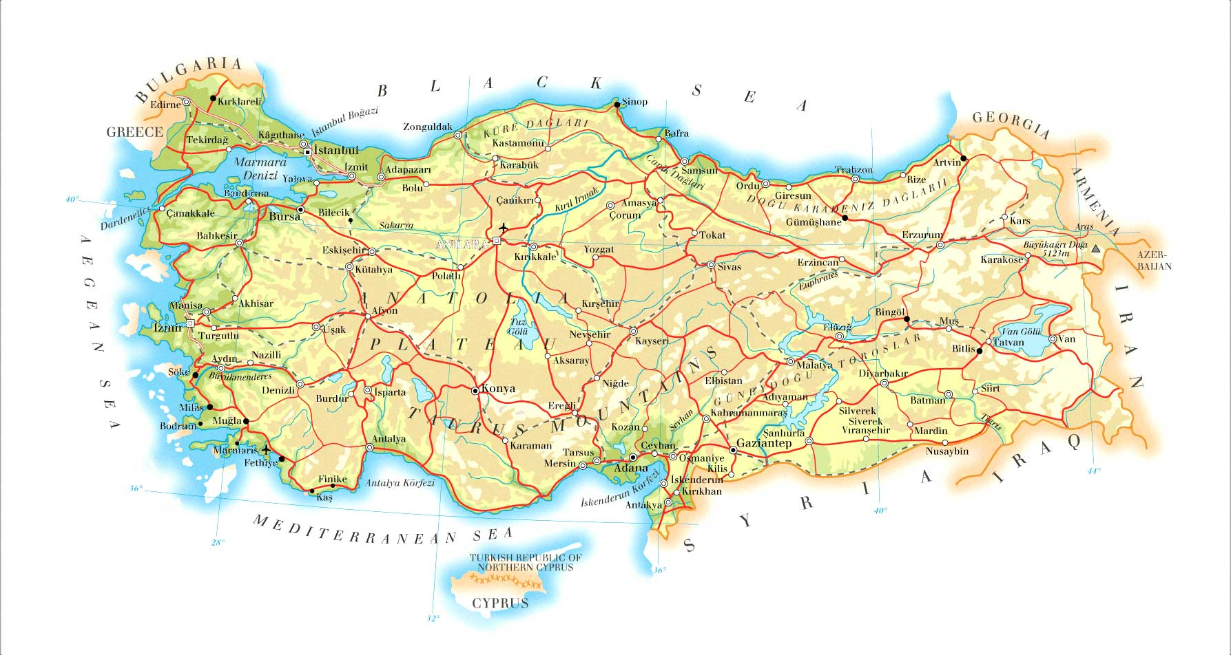
The country is encircled by seas on three sides: the Aegean Sea to the west, the Black Sea to the north and the Mediterranean Sea to the south.
Turkey is bordered by eight countries: Bulgaria to the northwest; Greece to the west; Georgia to the northeast; Armenia, Azerbaijan and Iran to the east; and Iraq and Syria to the southeast.

Slide 8
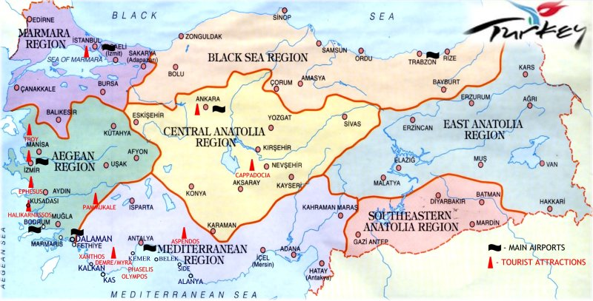
There are 7 regions and 81 provinces in Turkey.

Slide 9
SOME INFORMATION ABOUT TURKEY
Capital city : Ankara
Language : Turkish
Political Structure : Parliamentary democracy
Memberships : Council of Europe, NATO, OECD, BSEC, OIC, and many other international organizations
NATO: North Atlantic Treaty Organization
OECD: Organisation for Economic Co-operation and Development
BSEC: Black Sea Economic Cooperation
OIC : Organization of the Islamic Conference

Slide 10
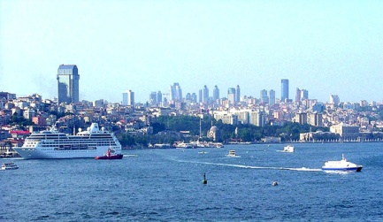
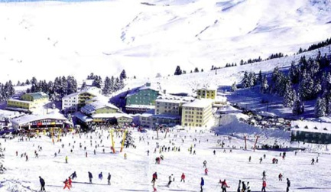
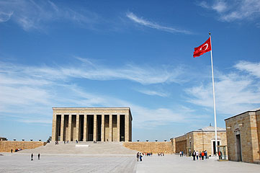
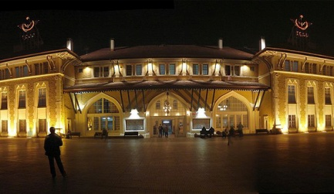
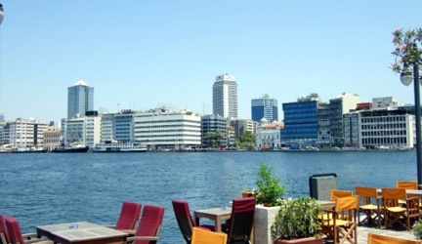
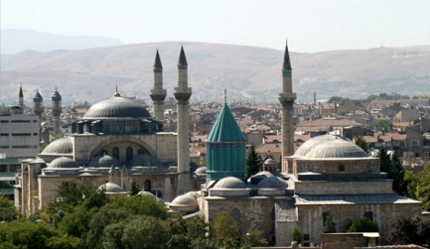
The Largest Cities of Turkey
İstanbul - 12.697.164
Bursa - 3.507.963
Ankara - 4.548.939
Adana - 2.026.319
İzmir - 3.795.978
Konya - 1.969.868

Slide 11
Our National Holidays
1st January - New Year’s Day
23rd April - National Sovereignty and Children’s Day
1st May - Labor and Solidarity Day
19th May - The Commemoration of Atatürk, Youth and Sports Day
30th August - Victory Day
29th October - Republic Day

Slide 12
Demographics
Population : 75 million (nearly)
Growth rate : 1.2 %
Age structure
0-14 years : 25.5 %
15-64 years : 67.7 %
65-over : 6.8 %

Slide 13
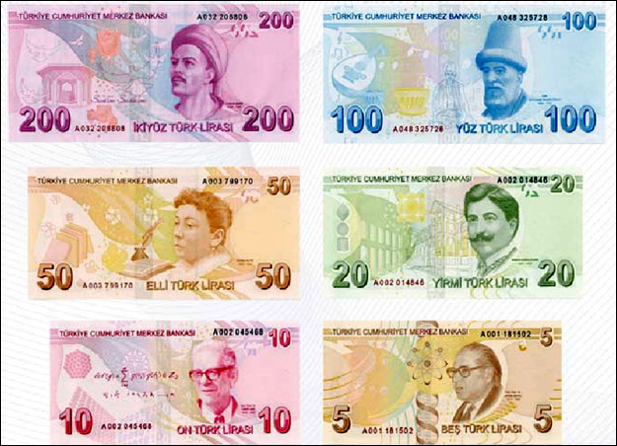
Currency
The currency used in Turkey is Turkish Lira
1 Euro = 2.85 Turkish Lira (02/06/2014 exchange rates)

Slide 14
The main airports of Turkey are in İstanbul, Ankara and İzmir
There are two airports in İstanbul; Atatürk Airport and Sabiha Gökçen Airport.
There is one airport in Ankara; Esenboğa Airport.
There is one airport in İzmir; Adnan Menderes Airport.
There is also one airport in Denizli; Çardak Airport.

Slide 15
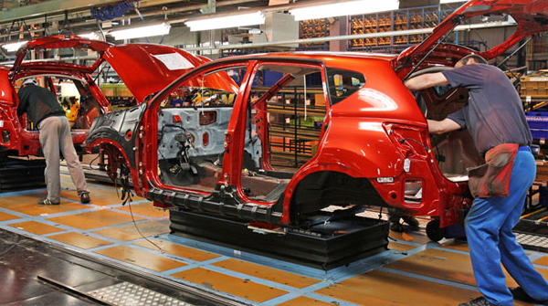
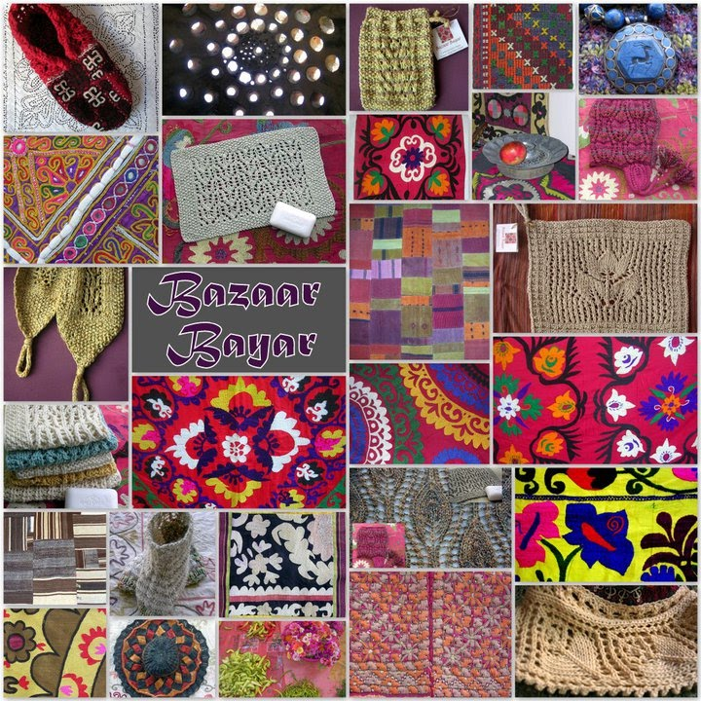
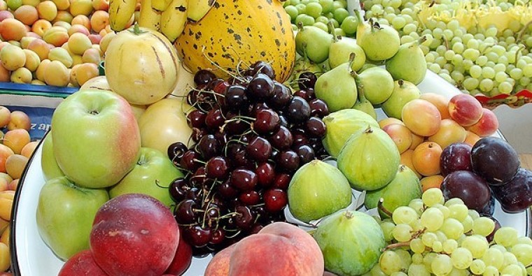
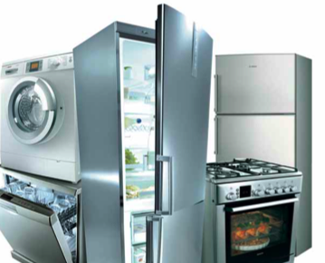
Economy
16th largest economy in the world
Textiles
Vehicles
Agricultural products
Consumer electronics

Slide 16
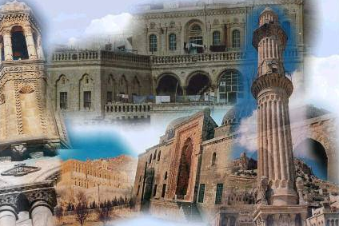
Tourism
Hunting
Rafting
Winter Sports
Culture
Silk Road
Thermal Resorts
Golf
Ornithology
Yachting
Botanic
Highlands
Air Sports

Slide 17
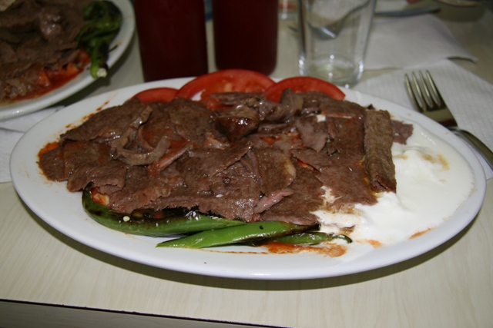
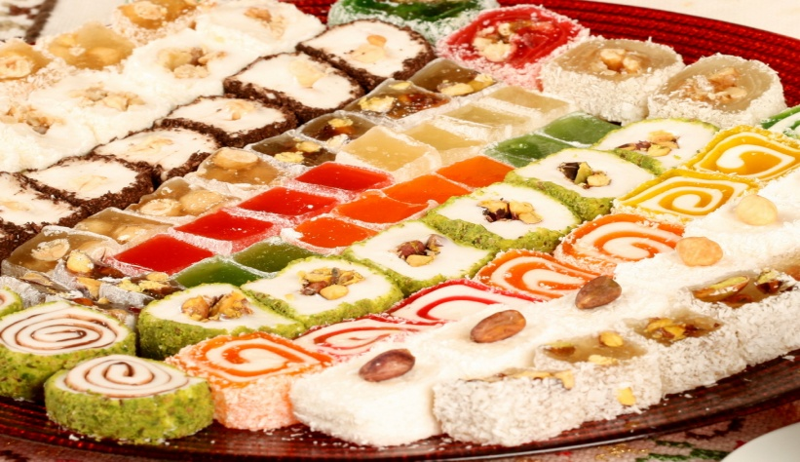
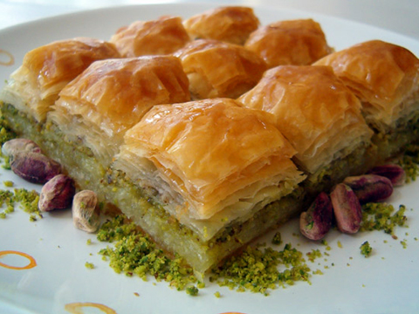
Turkish Cuisine
Turkish Delight (Lokum)
Famous Turkish sweet
Döner Kebap
Famous Turkish meal
Baklava
Famous Turkish sweet
Tea (Çay)
Famous Turkish drink

Slide 18
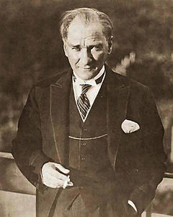
PEACE AT HOME, PEACE IN THE WORLD
Mustafa Kemal ATATÜRK

